Slide 1



Laser-Plasma Accelerator Workshop (LPAW 2019)
Split, 9 May 2019
Diagnostics for plasma-
based electron accelerators
Mike Downer
University of Texas at Austin
• Diagnostics: a new LPAW working group
• Looking back: What new diagnostics have we developed for LPAs?
• Looking forward: What new LPA diagnostics do we still need?
MC Downer, R Zgadzaj, A Debus, U Schramm & MC Kaluza,
“Diagnostics for plasma-based electron accelerators,”
Rev. Mod. Phys. 90, 35002 (2018).
“Diagnostics in widespread use with conventional RF accelerators have,
by and large, proven insufficient for characterizing plasma-based
electron accelerators.”
Notes:
Limit scope: diagnostic innovations specifically spurred by plasma-based electron accelerators.
Reference to RMP article. New diagnostics WG in LPAW.
Look back over past 2 decades: what new diagnostics have we developed?
Look forward over next decade: What are the challenges?

Slide 2
Plasma-based accelerators posed
a dual diagnostic challenge ...
e-bunches can be ...
... transversely small: 0.1 < σ_{x} < 1µm
... longitudinally short: 0.3 < σ_{z} ~ 3 µm (1 < τ < 10 fs)
transverse normalized emittance 0.1 < ε_{n} ≤ 1 mm mrad
condensed matter w/o ions
2. Plasma accelerator (PA) structures are ...
... tens of µm size ... evolving
... luminal velocity ... transient
How do we diagnose them in the laboratory?

Slide 3
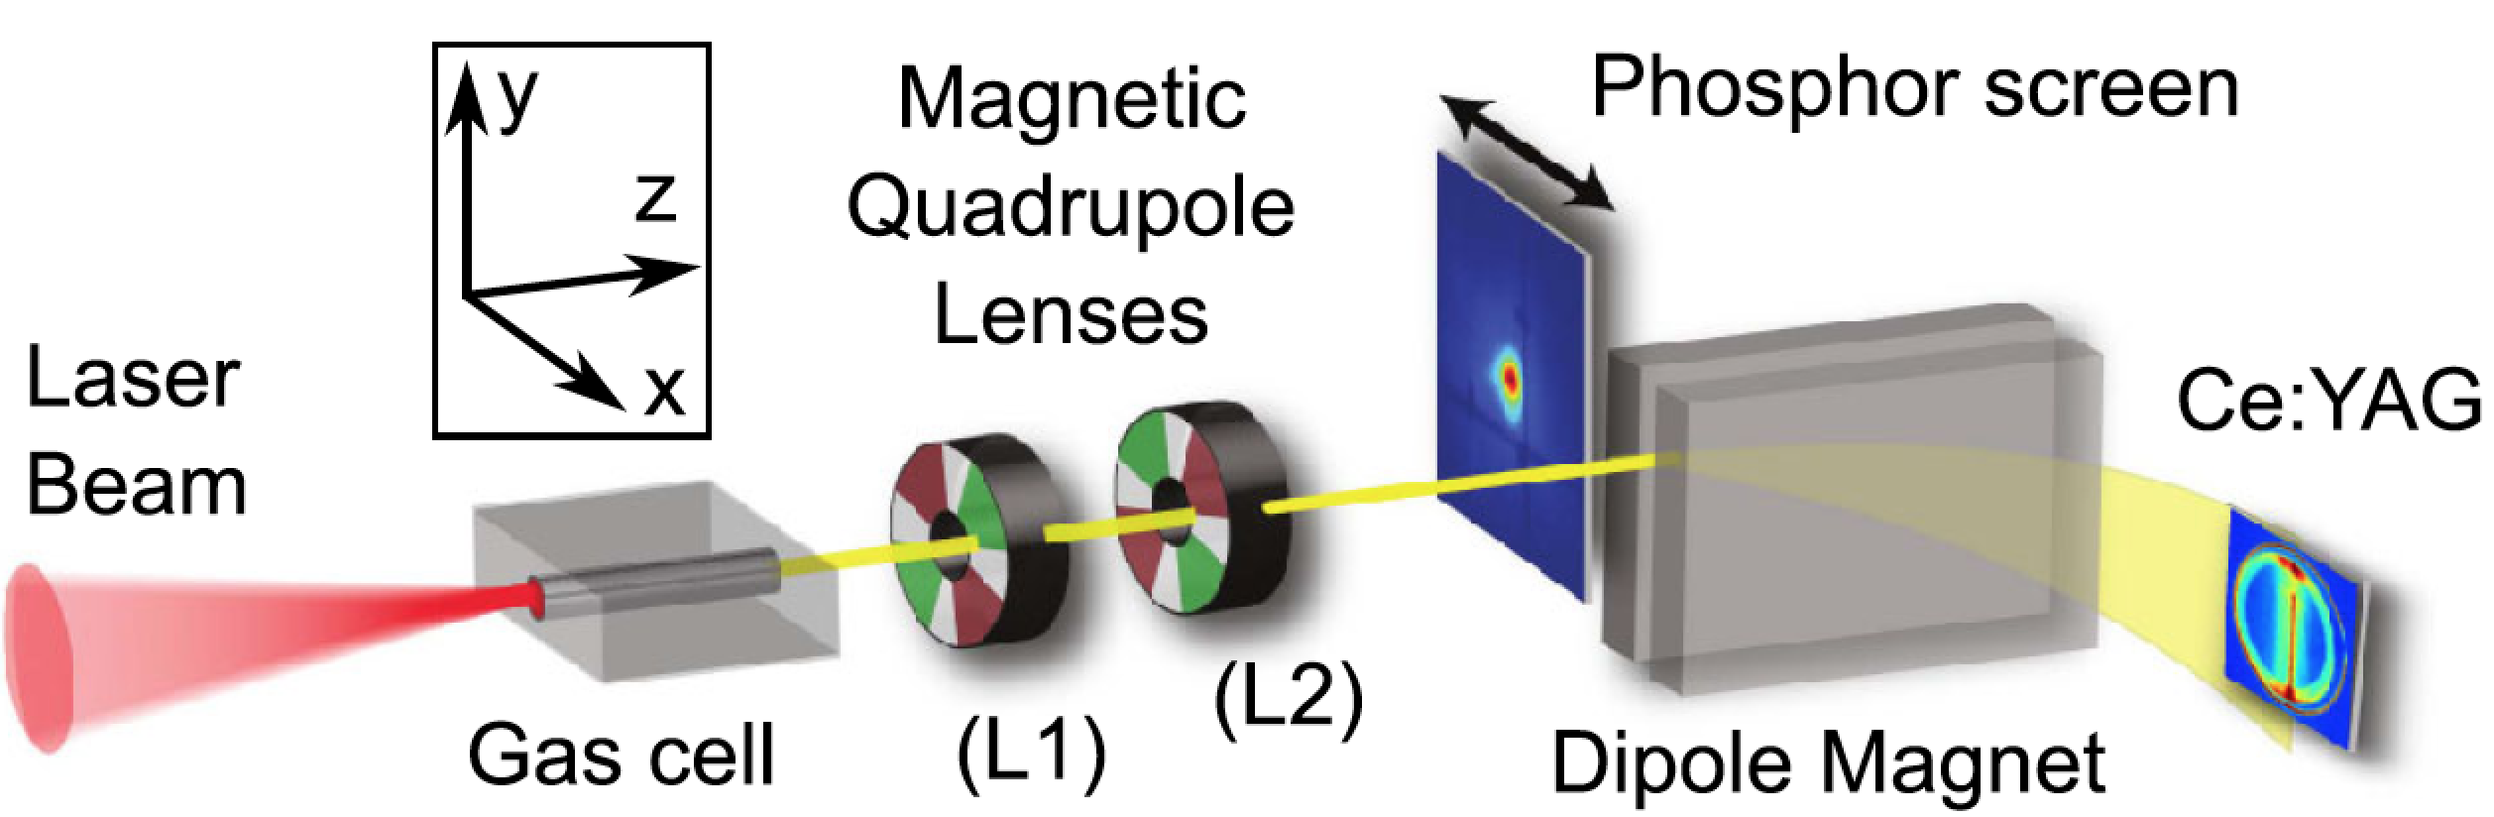
Early measurements of normalized transverse emittance ε_{N}
of PA*-electrons adopted conventional techniques
*plasma-accelerated
1) Intercepting masks: “Pepper-pots”
Fritzler, PRL 92, 165006 (2004)
Sears, PR ST-AB 13, 092803 (2010)
Brunetti, PRL 105, 215007 (2010)
Cianchi NIM-A 720, 153 (2013)
e-bunch
• only set upper limit
ε_{n} ≤ 1 mm mrad
• measurement is invasive
Challenge: small source size, large energy spread & divergence
phase space difficult
to sample adequately
2) Focus-scans
Weingartner, PR-STAB 15, 111302 (2012)
van Tilborg, PRL 115, 184802 (2015)
Barber, PRL 119, 104801 (2017)
• resolved ε_{n} = 0.2 mm mrad
• measures ε_{n} in one shot
• ε_{n} grows in apparatus
energy-resolved
beam size
• measurement is invasive
Challenge: PA beams have ~5% energy spread, not 0.1%

Slide 4


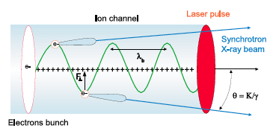
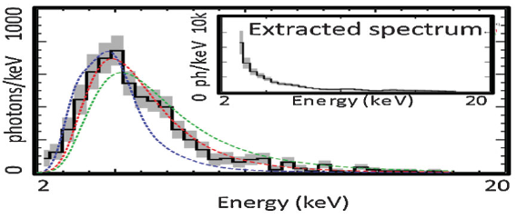
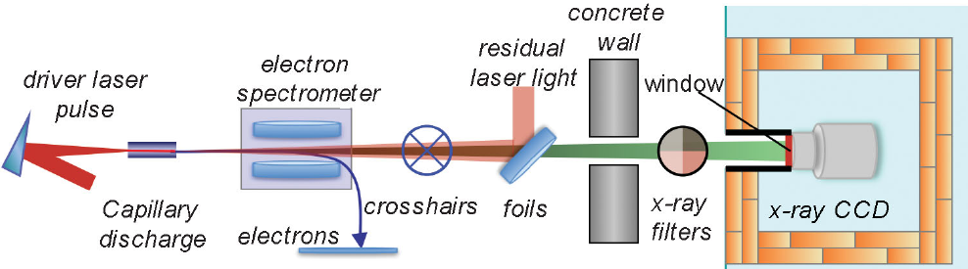


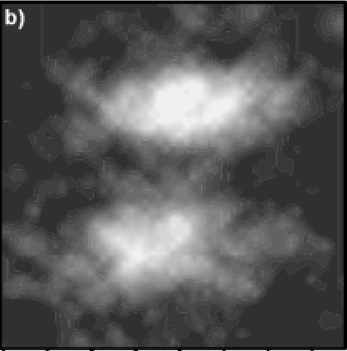

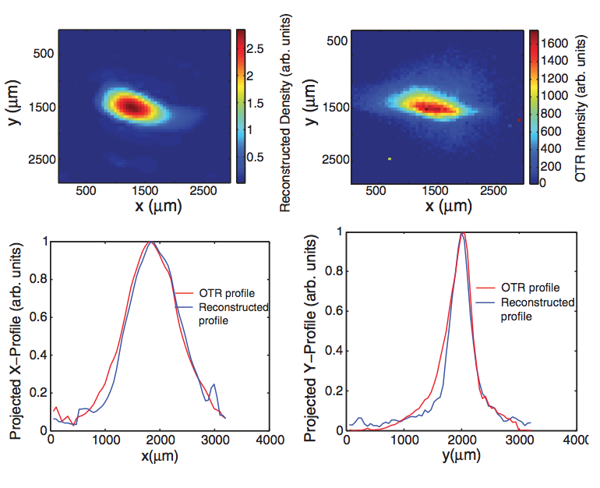
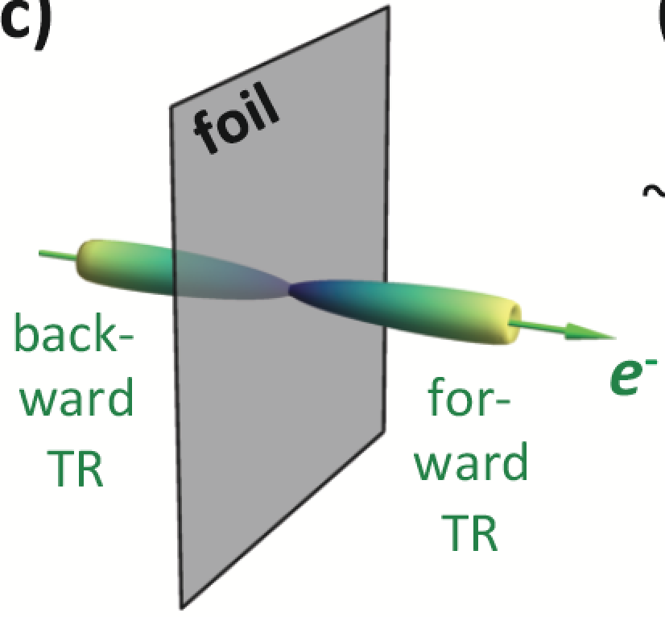
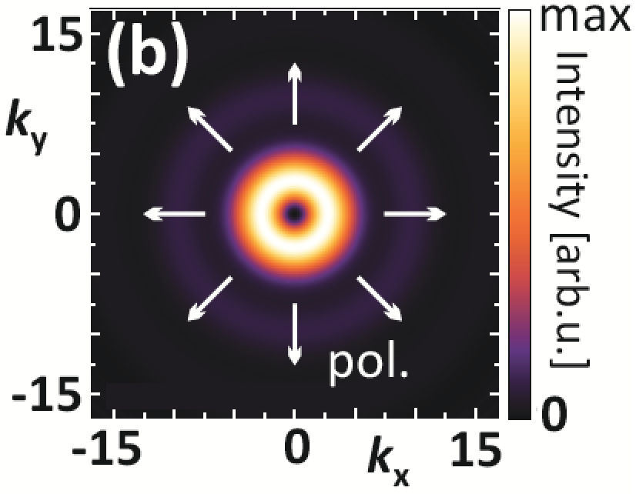
Radiation from plasma-accelerated e-
bunches characterizes ε_{N} non-invasively
1) Betatron x-ray spectroscopy: ε_{n} inside PA
x-ray photon counting spectrum
Plateau, PRL 109, 064802 (2012)
Schnell, PRL 108, 075001 (2012)
Köhler, NIM-A 829, 265 (2016)
σ_{x} = 0.3 µm
r_{β}
σ_{x} = 0.1 µm
Ta Phuoc (LOA), Mon 10:00
“Recent developments of betatron sources at LOA”
σ_{x} = 0.03 µm
Pablo San Miguel (LOA), Tues 15:20, “γ-rays in beam-plasma interaction as a diagnostic
for emittance growth in PWFA and for beam filamentation instabilities”
Alec Thomas (UMich), Wed 11:00
“X-rays from Laser Wakefield Accelerators”
ε_{n} ~ γσ_{x}σ_{θ} ~ 0.1 mm mrad
LPA
ε_{n} = [<x²><γ²x’²> - <γxx’>²]^{1/2}
≈ 0.06 mm mrad
Curcio, PR-AB 20, 012801 (2017)
2) Thomson x-ray backscatter
spectroscopy: ε_{n} outside PA
3) Transition Radiation (TR) imaging
σ_{x} = 1.5 µm beam
TR point spread
function (one e-)
σ_{x} = 6 µm beam
driver
scatter
magnet
θ
x-ray
detector
e-
Wenchao Yan (ELI), Wed 11:30
“Inverse Compton x-ray source based
on LWFA”
jet
Jochmann (2013)
HZDR
ε_{n} ≈ 0.15 mm mrad
at z = 1.5 mm
20
dN_{x}/dE_{x}
10
12
θ (mrad)
10
10 µm
Golovin, Sci. Rpts. 6,
24622 (2016)
8
Karataev, PRL 107,
164801 (2011)
2 µm
0
6
hν_{x} (keV)
Notes:
Production of ultra-low emittance beams in PWFA via e.g. Trojan Horse is a major challenge. This is an example of advanced emittance diagnosis in the context of LPA.
This answer’s yesterday’s question about state of the art in emittance for LPAs.
The photon-counting method may be restricted to x-ray photon energies in the 2-20 keV range (see Plateau).
Integrates over emission angle.

Slide 5
Early measurements of temporal profile of PA
e-bunches also relied on traditional methods ...
... electro-optic (eo) profiling:
¹Casalbuoni, DESY Tech. Rep. 2005-01(2005)
²van Tilborg, PRL 96, 014801 (2006)
³Berden, PRL 99, 164801 (2007)
⁴Debus, PRL 104, 084802 (2010)
• eo crystal converts...
... bunch’s Lorentz-contracted E profile¹
or ... THz CTR pulse generated by bunch²⁻⁴
into optical signal of similar τ_{b}
• noninvasive, single-shot
* temporal resolution limited by
absorption, dispersion of eo
crystal at THz frequencies
• shortest τ_{b} reported:
~30 fs FWHM⁴

Slide 6
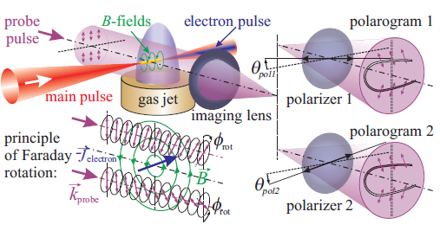
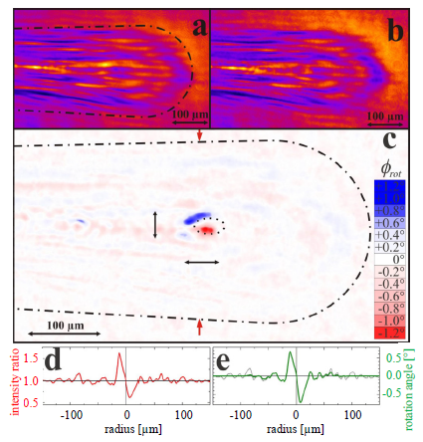
Magneto-optic bunch length measurements
overcame material limits of eo measurements
Kaluza, PRL 105, 115002 (2010); Buck, A., Nature Phys. 7, 543 (2011)
5.3fs
• shortest τ_{b} reported:
~5 fs FWHM
• Lorentz-contracted B-field (~MG)
of e-bunch locally magnetizes
plasma bubble “wall”
• Magnetized region rotates polarization
of transverse ~5 fs probe pulse

Slide 7

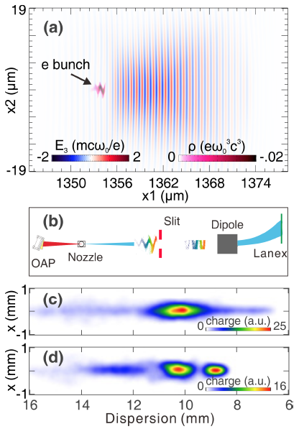
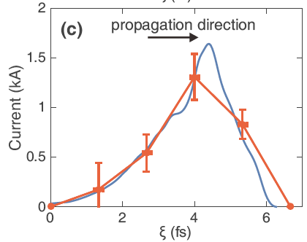
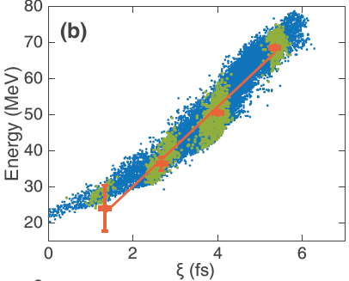
Laser “deflecting cavity” measures duration &
“slice ∆E” of chirped ultrashort LPA e⁻ bunches
C. J. Zhang, Phys. Rev. Accel. Beams 19, 062802 (2016)
cf. RF transverse deflecting cavities for ps e-bunches: Behrens, PR-STAB 15, 062801 (2012)
Measurement
Reconstructed longitudinal current profile
drive laser pulse
(f)
chirped
reconstructed
longitudinal
current
set-up
(e) reconstructed
longitudinal
phase
without slit
∆E_{slice} << ∆E_{tot}
with slit

Slide 8


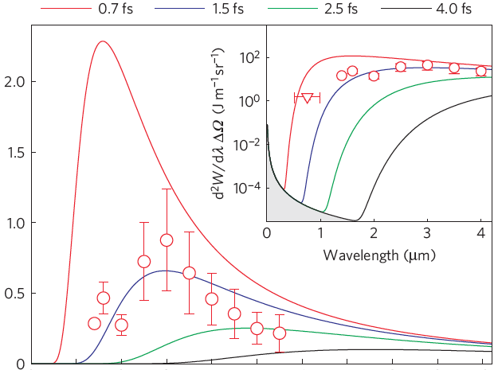
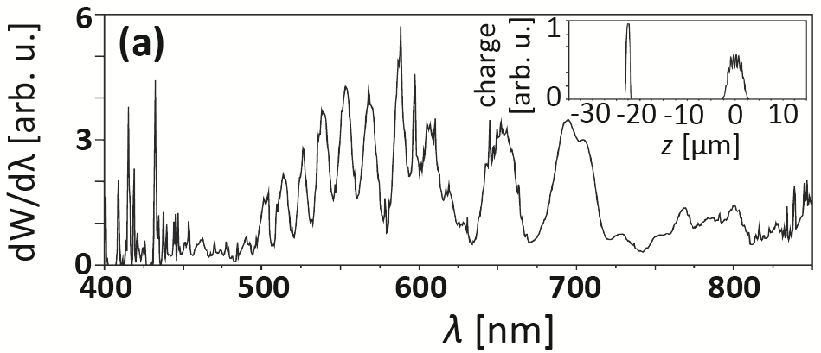
Coherent Transition Radiation (CTR) spectroscopy
reconstructs ~1 fs duration e-bunch temporal profiles
driver
TR foil
multi-octave
spectrometer
magnet
UV to
mid-IR
0.7 fs
1.5 fs
2.5 fs
4 fs
jet
e-
Lundh, Nat. Phys. 7, 219 (2011)
Spectral fringes reveal temporal micro-bunching
Glinec, PRL 98, 194801 (2007)
3-octave CTR spectrum
(0.55 – 5.5 µm)
|F(ω)|
ITR
σ_{z} > λ_{TR}
|f(z)|
1-octave
CTR
spectrum
(0.4 -0.8 µm)
dW/dλ (nJ µm⁻¹)
CTR
σ_{z} < λ_{TR}
0
2
4
6
8
10
Iterative reconstruction of temporal profile
Wavelength (µm)
TR becomes coherent when σ_{z} ≤ λ_{TR}:
Heigoldt, PR-STAB 18, 121302 (2015)
4-octave
CTR
spectrum
(0.4 -7 µm)
incoherent
coherent
Reconstructed
bunch profiles
Alexander Debus (HZDR), Mon 18:30
“Broadband, spectral, single-shot CTR
diagnostics showing impact of injection
scheme on LWFA bunch profiles”
No spectral
phase ψ(ω).
N-electron
TR spectrum
single e⁻
TR spectrum
Phase-retrieval
algorithm:
Bajlekov,
PR-STAB 16,
040701 (2013)
form factor:
Notes:
Beamstrahlung is the radiation from one beam of charged particles in linear colliders caused by its interaction with the electromagnetic field of the other beam. Coined by J. Rees, “Limitations on performance of e+e- storage rings and linear colliding beam systems at high energy,” It is a source of radiation loss in colliders. See file “Rees, Beamstrahlung.pdf” in OSU colloqium2016 folder.

Slide 9
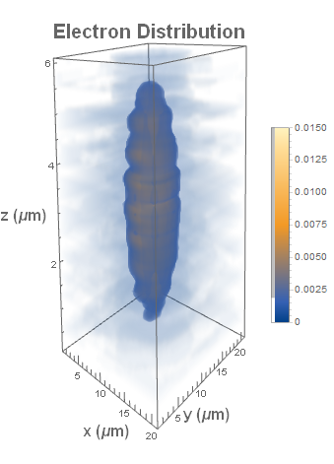
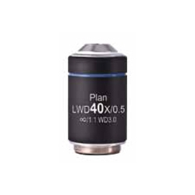
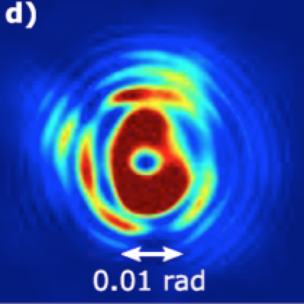
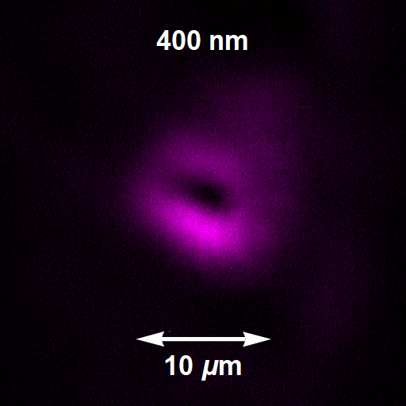
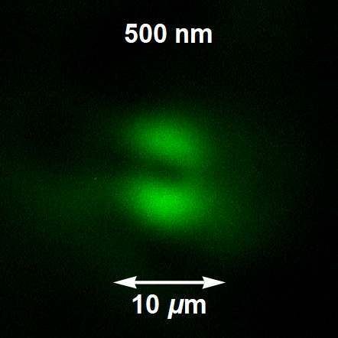
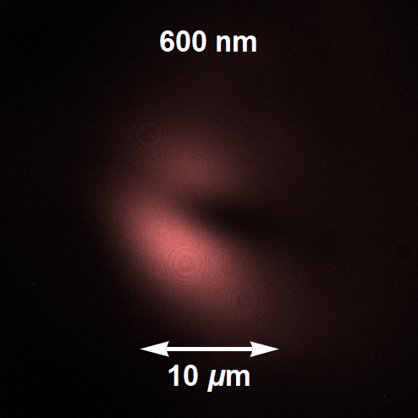
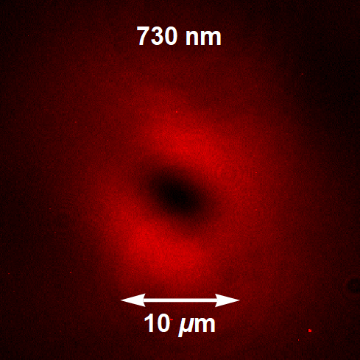
Toward 3D reconstruction of LPA beam profiles
from spectroscopic COTR imaging, interferometry
LaBerge, Wed 18:00, “Multi-spectral COTR imaging & interferometry...”
LPA drive
laser pulse
foil 1
foil 2:
pC/µm³
gas
Jet
e⁻
Partial
3D
bunch
recon-
struction
10
MO
3 µm
COTR
spectro-
meter
0
σ_{x,y} ≈ 2 ± 0.3 µm
CCD
10 µm
10 µm
COTR inter-
ferometry
f
CCD
Multi-spectral COTR images
CCD
10 µm
CCD
CCD
400 nm
500 nm
600 nm
730 nm

Slide 10
LPA researchers have also advanced diagnostics of
e-bunch charge Q, energy distrib^{n} dN_{e}/dE_{e}, energy spread ∆E_{e}
e-bunch property | Traditional diagnostics | Challenges for PA¹ electrons | Solutions, References
Total Q | ICTs² | Noisy environment (EMP,³ low-E_{e} electrons) | Shielded, filtered ICTs Nakamura 2016 sensitivity: 1 pC < Q < 1 nC
Space-resolved Q (basis of e-spectrometers) | • Luminescing screens • Imaging Plates (IPs) | Response to fs, hi-I_{peak} PA¹ e-bunches? | New calibrations Buck 2010, Kurz 2018
dN_{e}/dE_{e} | magnetic spectrometer | • MeV - GeV E_{e} range • mrad θ_{launch} range | • 2–plane detection Pollock 2011, Wang 2013 • Und^{r} rad^{n} spectrosc. Anania 2014, Gallacher 2009
∆E_{e} of main peak | as for dN_{e}/dE_{e} | ∆E_{e}/E_{e} < 0.01 unachievable? | • slice ∆E_{e} diagnostics ω-domain: Lin 2012 time-domain: Zhang 2016
References:
Abbreviations:
¹PA = Plasma-Accelerator
²ICT = Integrating Current Transformer
³EMP = Electro-Magnetic Pulses
Lin, PRL 108, 094801 (2012)
Nakamura, PPCF 58, 034010 (2016)
Pollock, PRL 107, 0450001 (2011)
Wang, Nat. Commun. 4, 1988 (2014)
Zhang, PR-STAB 19, 062802 (2016)
Anania, APL 104, 264102 (2014)
Buck, Rev. Sci. Instrum. 81, 033301 (2010)
Gallacher, Phys. Plasmas 16, 093102 (2009)
Kurz, Rev. Sci. Instrum. 89, 093303 (2018)
see MD et al., Rev. Mod. Phys.90, 35002 (2018) for more detailed discussion

Slide 11
Plasma-based accelerators posed
a dual diagnostic challenge ...
e-bunches can be ...
... transversely small: 0.1 < σ_{x} < 1µm
... longitudinally short: 0.3 < σ_{z} ~ 3 µm (1 < τ < 10 fs)
transverse emittance 0.1 < ε_{n} ≤ 1 mm mrad
2. Plasma accelerator (PA) structures are ...
... tens of µm size ... evolving
... luminal velocity ... transient
How do we diagnose them in the laboratory?

Slide 12
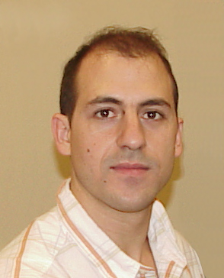

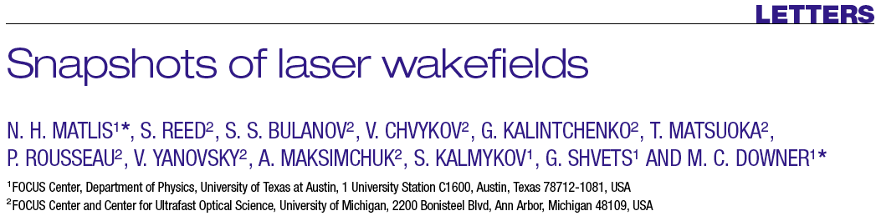
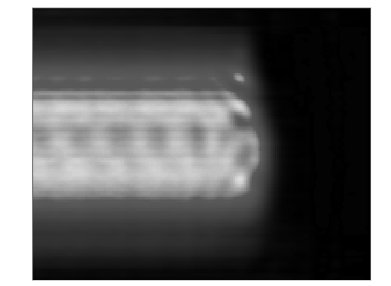
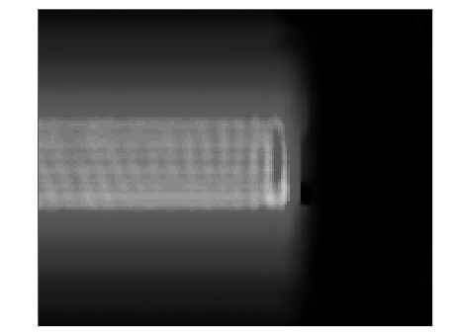
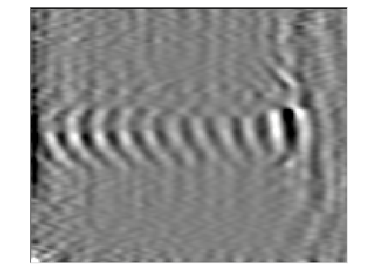
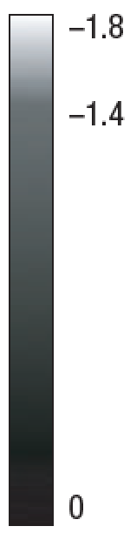
Nicholas Matlis
Laser-plasma accelerators come in many shapes & sizes
LONG WAVELENGTH
SHORT WAVELENGTH
CURVED WAVES
36 µm
15 µm
50 µm
probe phase shift (rad)
(prop. to n_{e})
n_{e0} = 0.95 × 10¹⁸ cm⁻³
10 TW pump
n_{e0} = 5.9 × 10¹⁸ cm⁻³
10 TW pump
n_{e0} = 2.2 × 10¹⁸ cm⁻³
30 TW pump
The ability to capture pictures of plasma waves helps us
understand and improve laser-plasma accelerators

Slide 13

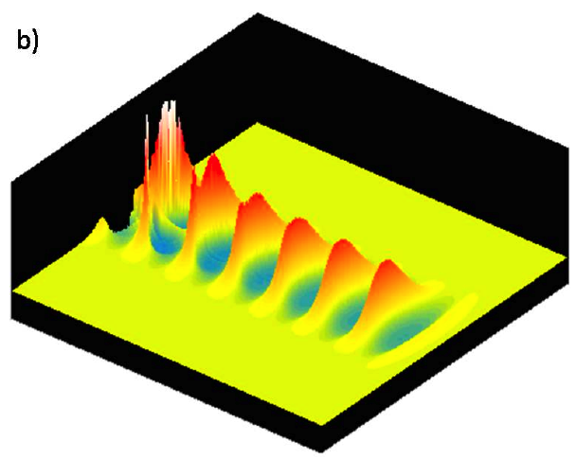
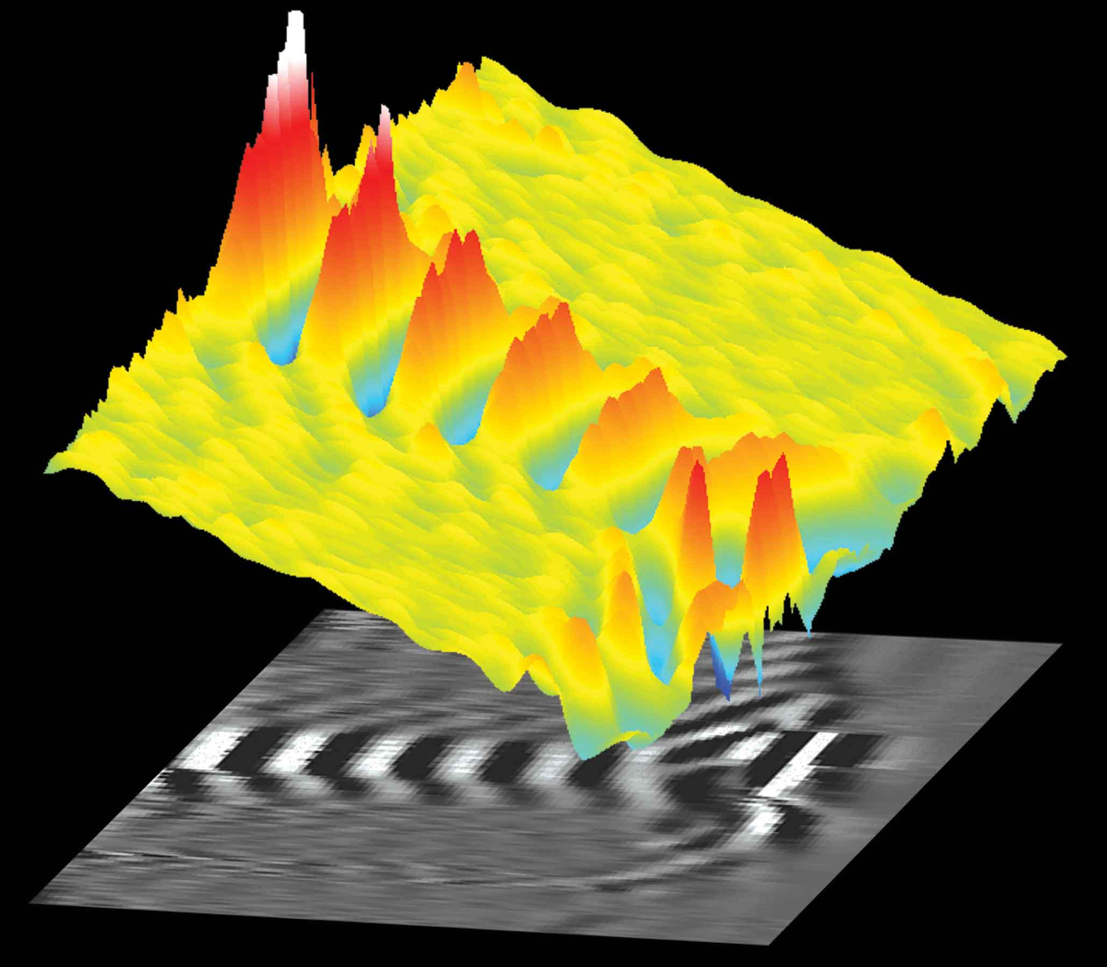
“Frequency Domain Holography” (FDH)
Images Quasi-Static Wakes in One Shot
Wakefield n_{e} = n₀ + δn_{e}(t)
30 TW Pump
to
spectrometer
Chirped
Reference
Chirped
Probe
Ionization
Front
• wave fronts curve relativistically
• waves compress & break behind pump
(new diagnostics can be a source of discovery!)
Experiment
Simulation
∆ϕ_{probe}(r,ζ)
Matlis, Nature Phys. 2,
749 (2006)
Dong, NJP 12,
045016 (2010).
n_{e}(r,ζ)
pump
60
60
0.4
0
0
ζ [ps]
r [µm]
r [µm]
0.4
0
60
ζ [ps]
0
60
n_{e} = 3 • 10¹⁸ cm⁻³

Slide 14

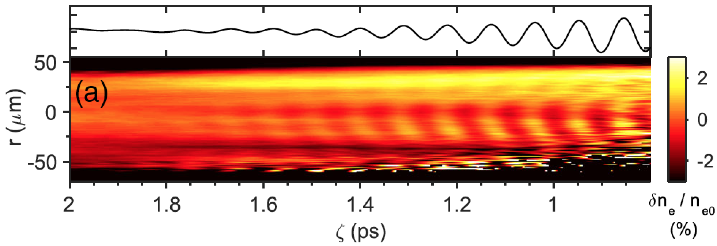
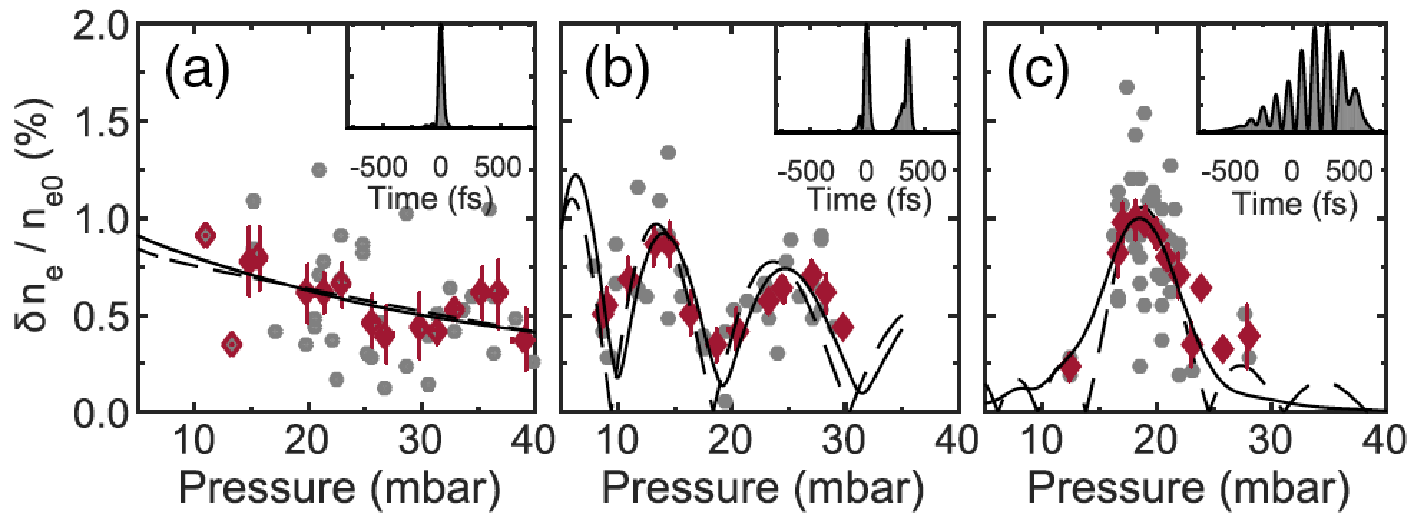
FDH supports tuning of plasma wakes
excited by multiple laser pulses ...
Cowley, PRL 119, 044802 (2017)
FD Hologram of wake excited by single pulse
Amplitudes of wakes excited by N pulses vs. plasma density
N = 1
N = 2
N = 7
resonant
excitation
conditions
... a path to efficient, high-rep-rate plasma accelerators

Slide 15
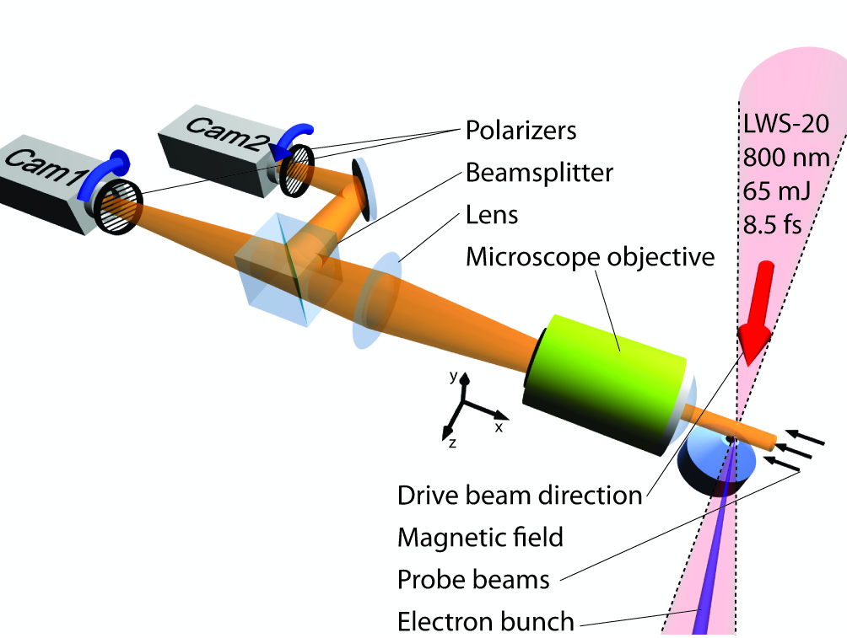
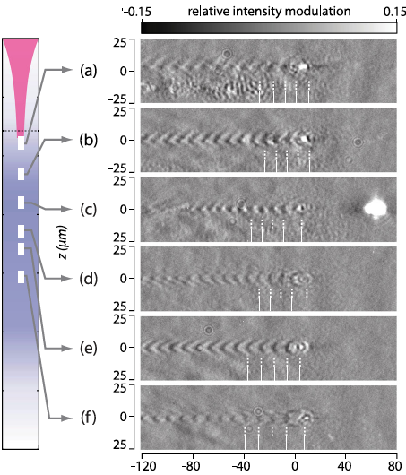
Transverse few-cycle probe shadow-
graphically images wake at selected ∆t
Buck, Nat. Phys. 7, 453 (2011); Sävert, PRL 115, 055002 (2015)
(1)
40-TW, 30 fs laser pulse drives plasma wake.
6 fs synchronized probe pulse impinges transversely.
(1) pump
(2)
Lens
Max Gilljohann (LMU), Mon 11:30, “Hybrid
acceleration: Studying PWFAs with LWFAs”
CCD
(3)
Probe shadowgraphs imaged at selected ∆t.
Pump
relative intensity modulation
(3)
camera
z
Stephan Kuschel (SLAC), Mon 14:40,
“Controlling self-injection treshold in LWFAs”
y
(2)
probe
x
0
Gas jet (n_{e} = 1.6 • 10¹⁹ cm⁻³)
Hao Ding (LMU) Mon 18:45, “Few cycle
shadowgraphy of plasma wave trains”
1
50 µm
Susanne Schöbel (HZDR) Mon 19:00, “Excitation of
beam-driven plasma waves in a hybrid LPWFA”
position in gas jet (mm)
PROS
• single-shot, non-invasive
• µm resolution,
2
CONS
• dynamic info requires multiple shots
• challenging to scale to n_{e} < 3e18 cm⁻³
• requires extremely short probe pulse
3
x – v_{pump}t (µm)

Slide 16
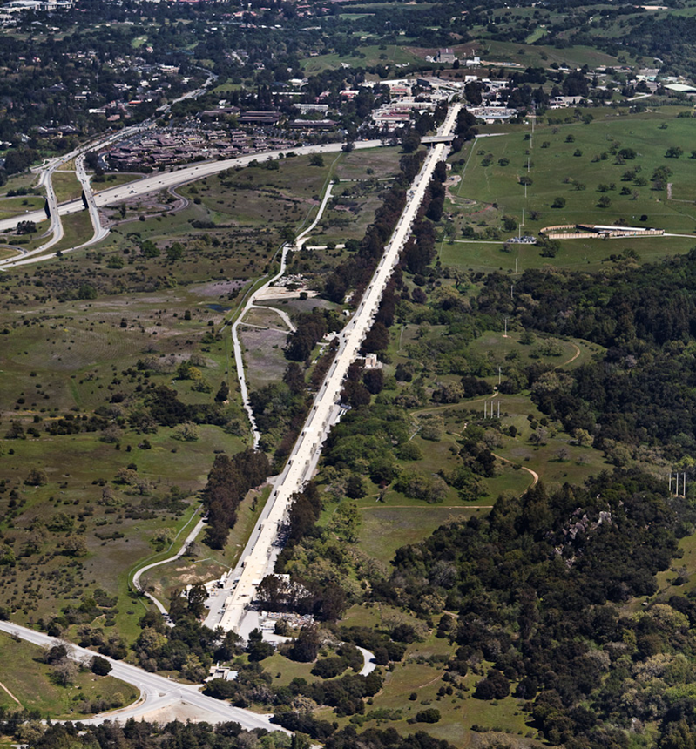

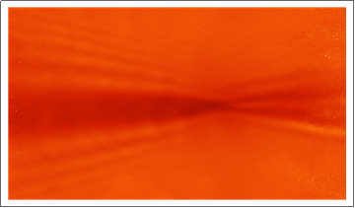
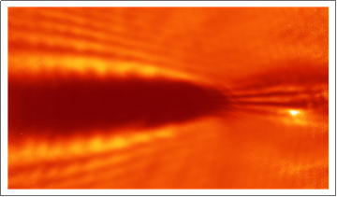
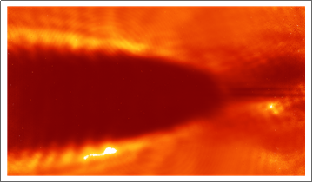
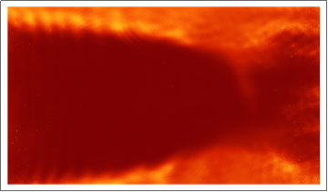
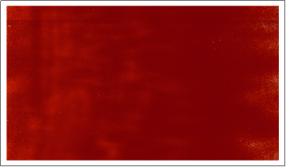


Grazing-angle shadowgraphy accesses
plasma accelerators @ n_{e} < 10¹⁷ cm⁻³...
Rafal Zgadzaj (UT) Mon 18:00, “Optical measurements of ns-scale
plasma evolution excited by beam-driven plasma wakes at FACET”
α = 0.01 rad
heat-pipe oven
1.5 m
SLAC e⁻ bunch
(20 GeV, 2 nC)
Li vapor
n_{a} = 0.8e17 cm⁻³
f/40 lens
laser probe
(0.8 µm, 0.1 ps)
∆t
CCD
1
∆t < 0
0.03 ns
0.3 ns
0.6 ns
0.9 ns
10 µs
r [mm]
0
5 cm
1
Konstantin Lotov, Mon 17:55, “Simulations of long-term
wakefield evolution in a radially bounded plasma”
... along with ns-scale ion motion physics,
in close dialog with simulations
Budker Institute for
Nuclear Physics

Slide 17
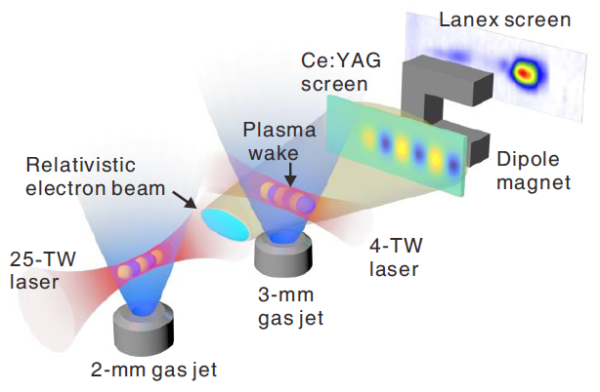
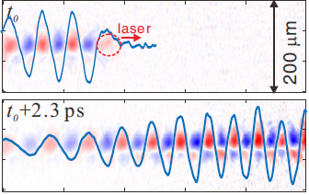
Relativistic few-fs LWFA e-bunch transversely probes electromagnetic fields of a subject LWFA
Zhang, PRL 119, 064801 (2017); ibid, Sci. Rpts | 6:29485
-Electron radiography is sensitive to electromagnetic fields of the the plasma wave and of the accelerated charge.
-Easily scaled to low densities.
100
t₀
1.2
110
Plasma density
8.7
LASER
GV/m
(d)
n_{e}
(10¹⁷cm⁻³)
0
LASER
-100
-1.2
-110
0
100
1.5
110
Position of downramp
220
t₀ + 2.3ps
Main wake
GV/m
(e)
n_{e} (arb.units)
-100
Weaker, secondary wake
-1.5
-110
Electron shadowgram
Injection
120
0
133
266
z(μm)
532
665
125
300
475
z(μm)
825
1000
Measurement
Simulation

Slide 18
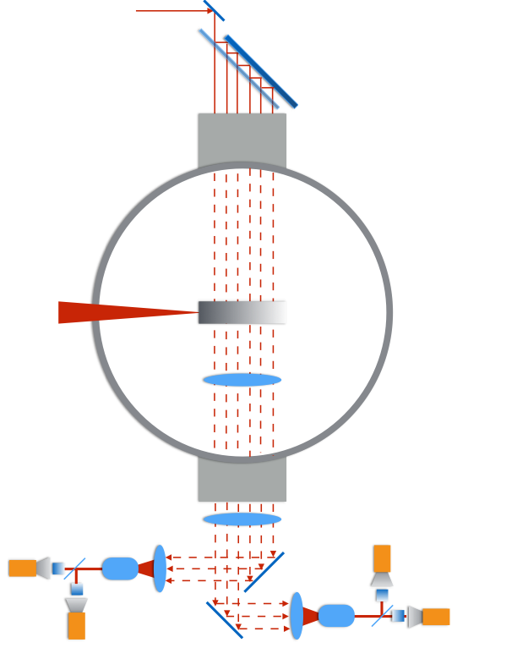
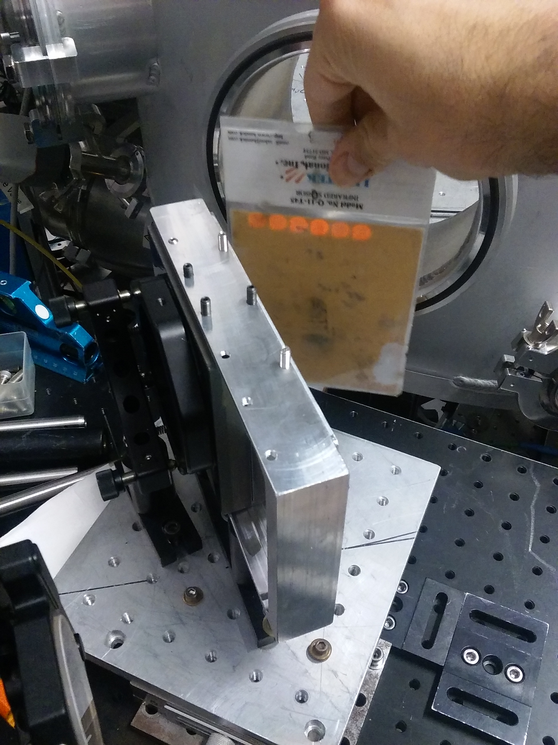
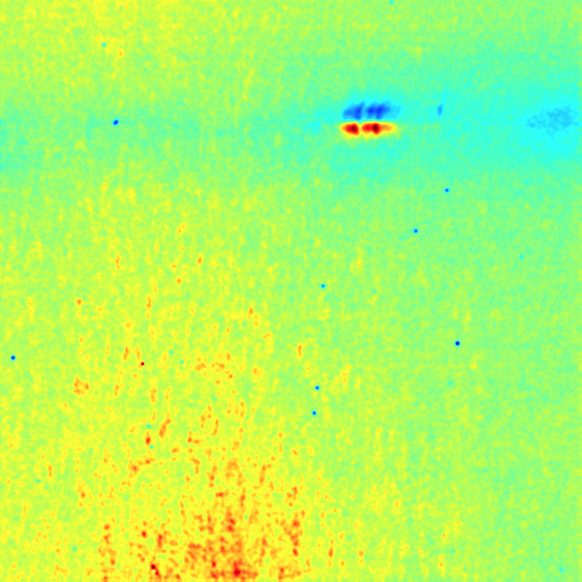
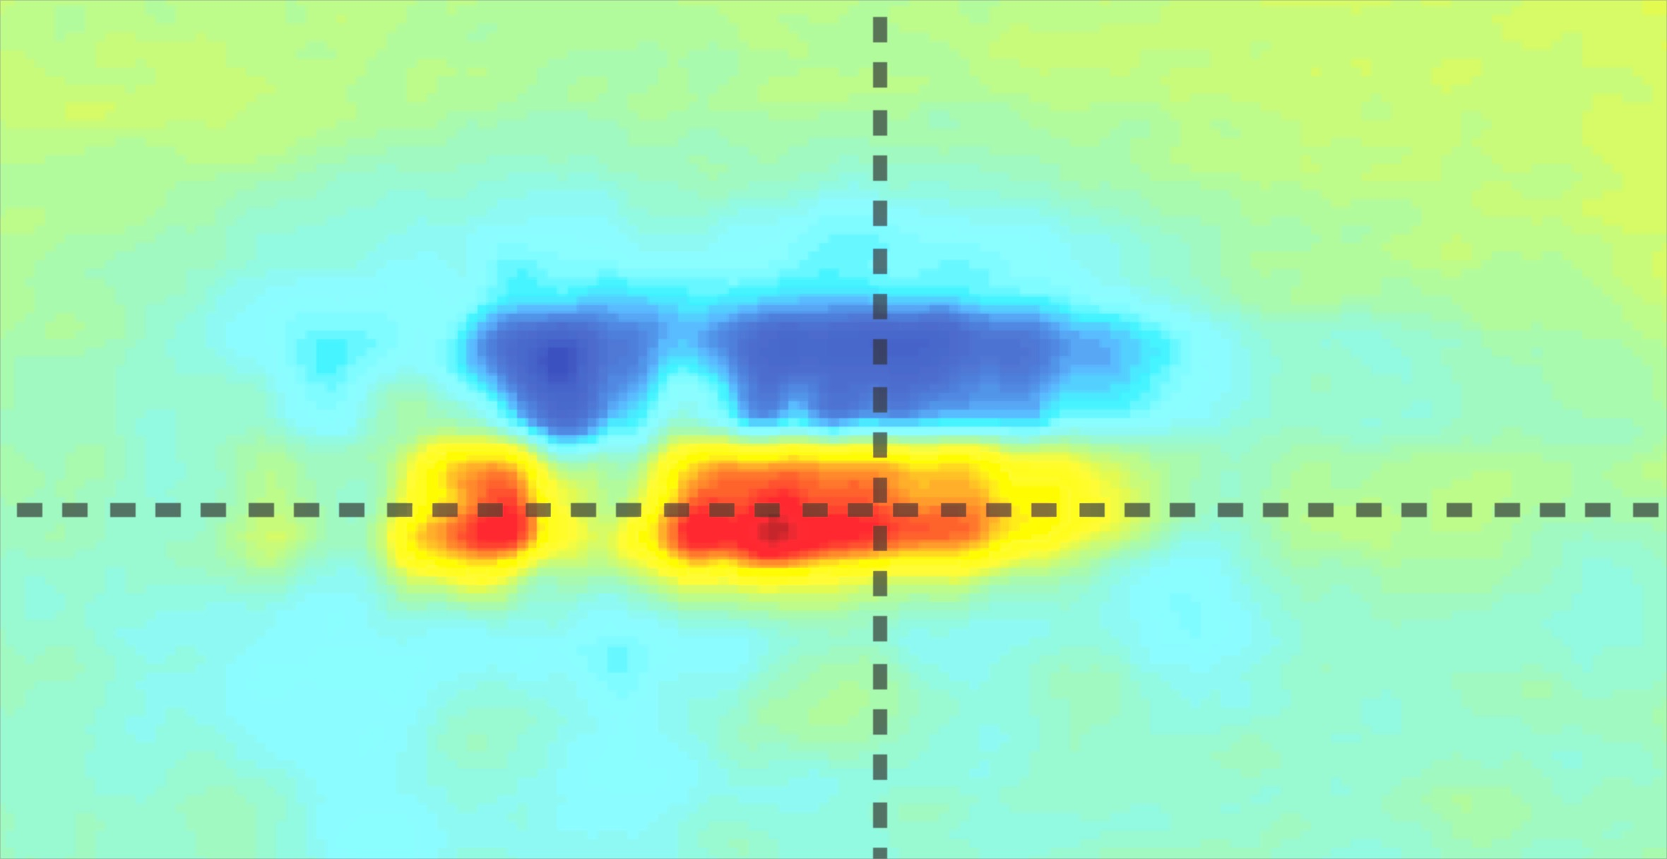
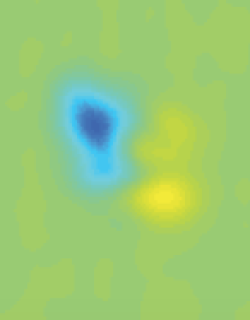
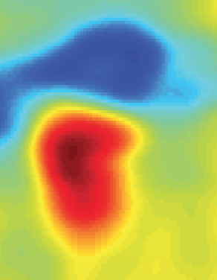
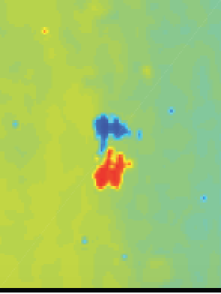
Single-shot Faraday rotation “streaks”
from bubble walls in n_{e0} = 3e17 cm⁻³
plasma, magnetized by 2 GeV e⁻
probe
(250 fs)
probe
multiplexer
vacuum
chamber
Yen-Yu Chang (UT), Mon 19:15 “ Single-shot
movies of evolving GeV LPAs by multiplexed
Faraday rotation”
pump
(150 fs, 90 J)
gas cell
side view
0
1
2
3
4
5
6
z (cm)
based on
technique
developed
by Kaluza,
PRL 105, 115002
(2010)
anamorphic imaging
camera A
camera C
camera B
camera D
pol
anamorphic imaging
shot #2
AF test pattern
shot #1
1
200 µm
Faraday rotation
angle (degrees)
0
-1
z
500 µm
500 µm
Notes:
Data from shot 860.

Slide 19
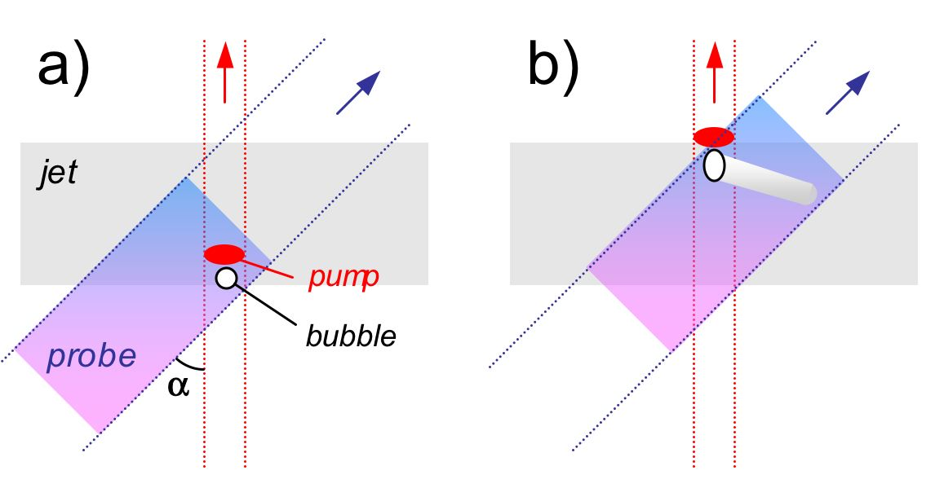
Frequency-Domain “Streak Camera”
Records EVOLUTION of Plasma Bubble
in ONE shot
Z. Li et al., Opt. Lett. 35, 4087 (2010)
___________, Nature Photonics 5, 68 (2011)
Zhengyan Li
phase streak
• Phase streak is a temporal sequence of the object’s projections
• We can record several of them simultaneously to recover
the object’s evolving structure tomographically

Slide 20






We’ve observed formation, propagation & collapse of
plasma bubbles with a frequency-domain streak camera
Li et al., Phys. Rev. Lett. 113, 085001 (2014)
ionization front
lineouts of bubble phase streak
electron
spectra
n_{e} = 1.3e19 cm⁻³
1.7e19 cm⁻³
λ_{pr} = 0.4µm
reference
probe
to spectrometer
8.6º
3 mm
gas jet
pump
30 fs,
1 J
probe phase shift
z [mm]
z [mm]
λ_{pu} = 0.8µm
2e19 cm⁻³
2.2e19 cm⁻³
optimum
electron
spectra
Data for 3 shots at
n_{e} = 1.7e19 cm⁻³:
50 MeV
75
100
50 MeV
75
100
1.5 L_{deph}
no electrons
9
6
bubble streak
line-outs
probe phase shift [rad]
3
z [mm]
z [mm]

Slide 21



Frequency-domain tomography (FDT) records multiple phase streaks in one shot…
3) Phase Streaks
Z. Li et al., Nature Commun. 5, 3085 (2014)
spectrometer
ϕ = 1º
ϕ = 27º
ϕ = -25º
CCD
ϕ = -65º
lens
ϕ = 68º
1) 2D Hologram
CT
glass
4) Tomographic
Reconstruction
lens
λ_{probe} [nm]
800 nm
pump
FT
800 nm
probe
gener-
ators
cascaded
4WM
2) Reciprocal 2D Hologram
window
and IFT
400 nm
probes
400 nm
ref. pulse
The ultimate 4D plasma
structure diagnostic!?

Slide 22




Single-shot tomographic movies unravel the complex physics of filament formation in Kerr media
Z. Li et al., Nature Commun. 5, 3085 (2014)
PUMP
PULSE
ENERGY
nonlinear
refractive
index ∆n
Propagation distance z_{ob} into medium
linear propagation
0.4 µJ
mild self-focusing
NLSE simulations
0.5 µJ
x_{ob} [µm]
strong self-focusing
0.6 µJ
arrested collapse
plasma generation
0.7 µJ
self-guided filament formation
ζ [fs]
Time from peak of pump pulse
Single-shot movie

Slide 23




Many diagnostics have contributed
to plasma electron acceleration science
1) Electromagnetic Emission from plasma wakes
Far IR (ω ~ ω_{p}):
Hamster PRL 71, 2725 (1993)
Thomas, PRL 98, 054802 (2007) – e⁻ injection
Gordon, PRL 98, 045004 (2008) - theory
Helle, PRL 105, 105001 (2010) - expt
wave-breaking rad^{n}:
(broadband)
SH eo shocks:
(from bubble walls)
schematic
expt
2) Light scattering from PA structures
transverse
probe (cτ_{pr} > λ_{p})
Clayton, PRL 54, 2343 (1985)
Gordon, PRL 80, 2133 (1998)
Ting, PRL 77, 5377 (1996)
Le Blanc, PRL 77, 5381 (1996)
Rafal Zgadzaj (UT) Mon 16:00, “CO₂-laser-driven LWFA
experiments at Brookhaven’s Accelerator Test Facility”
co-propagating
probe (cτ_{pr} > λ_{p})
3) Multi-shot pump-probe experiments
sub-λ_{p} electron
witness bunch
Rosenzweig, PRL 61, 98 (1988); PRA 39, 1586 (1989)
Kallos, PRL 100, 074802 (2008)
sub-λ_{p} optical
probe pulse
Siders, PRL 76, 3570 (1996)
Marqués, PRL 78, 3463 (1997)
I have highlighted those that visualize n_{e}(r,ζ,z) or E(r,ζ,z) over
substantial propagation distances z in one shot.

Slide 24
SUMMARY: plasma accelerator research has spurred, and continues to spur, innovation in diagnostics
1) e-bunch diagnostics: We can now measure
• ε_{N} << 0.1 mm mrad • τ_{b} ~ 1 fs
noninvasively, in one shot. Challenge: single-shot, non-
invasive 3D bunch reconstruction at arbitrary locations.
2) Plasma structure diagnostics: We can now visualize
• plasma density profiles • electric field profiles
of evolving, µm-scale, plasma accelerators noninvasively,
in one shot over cm to meter propagation lengths.
Challenge: single-shot 4D visualization
For a more compre-
hensive survey see:
MC Downer, R Zgadzaj, A Debus, U Schramm & MC Kaluza,
“Diagnostics for plasma-based electron accelerators,”
Rev. Mod. Phys. 90, 35002 (2018).

