Slide 1
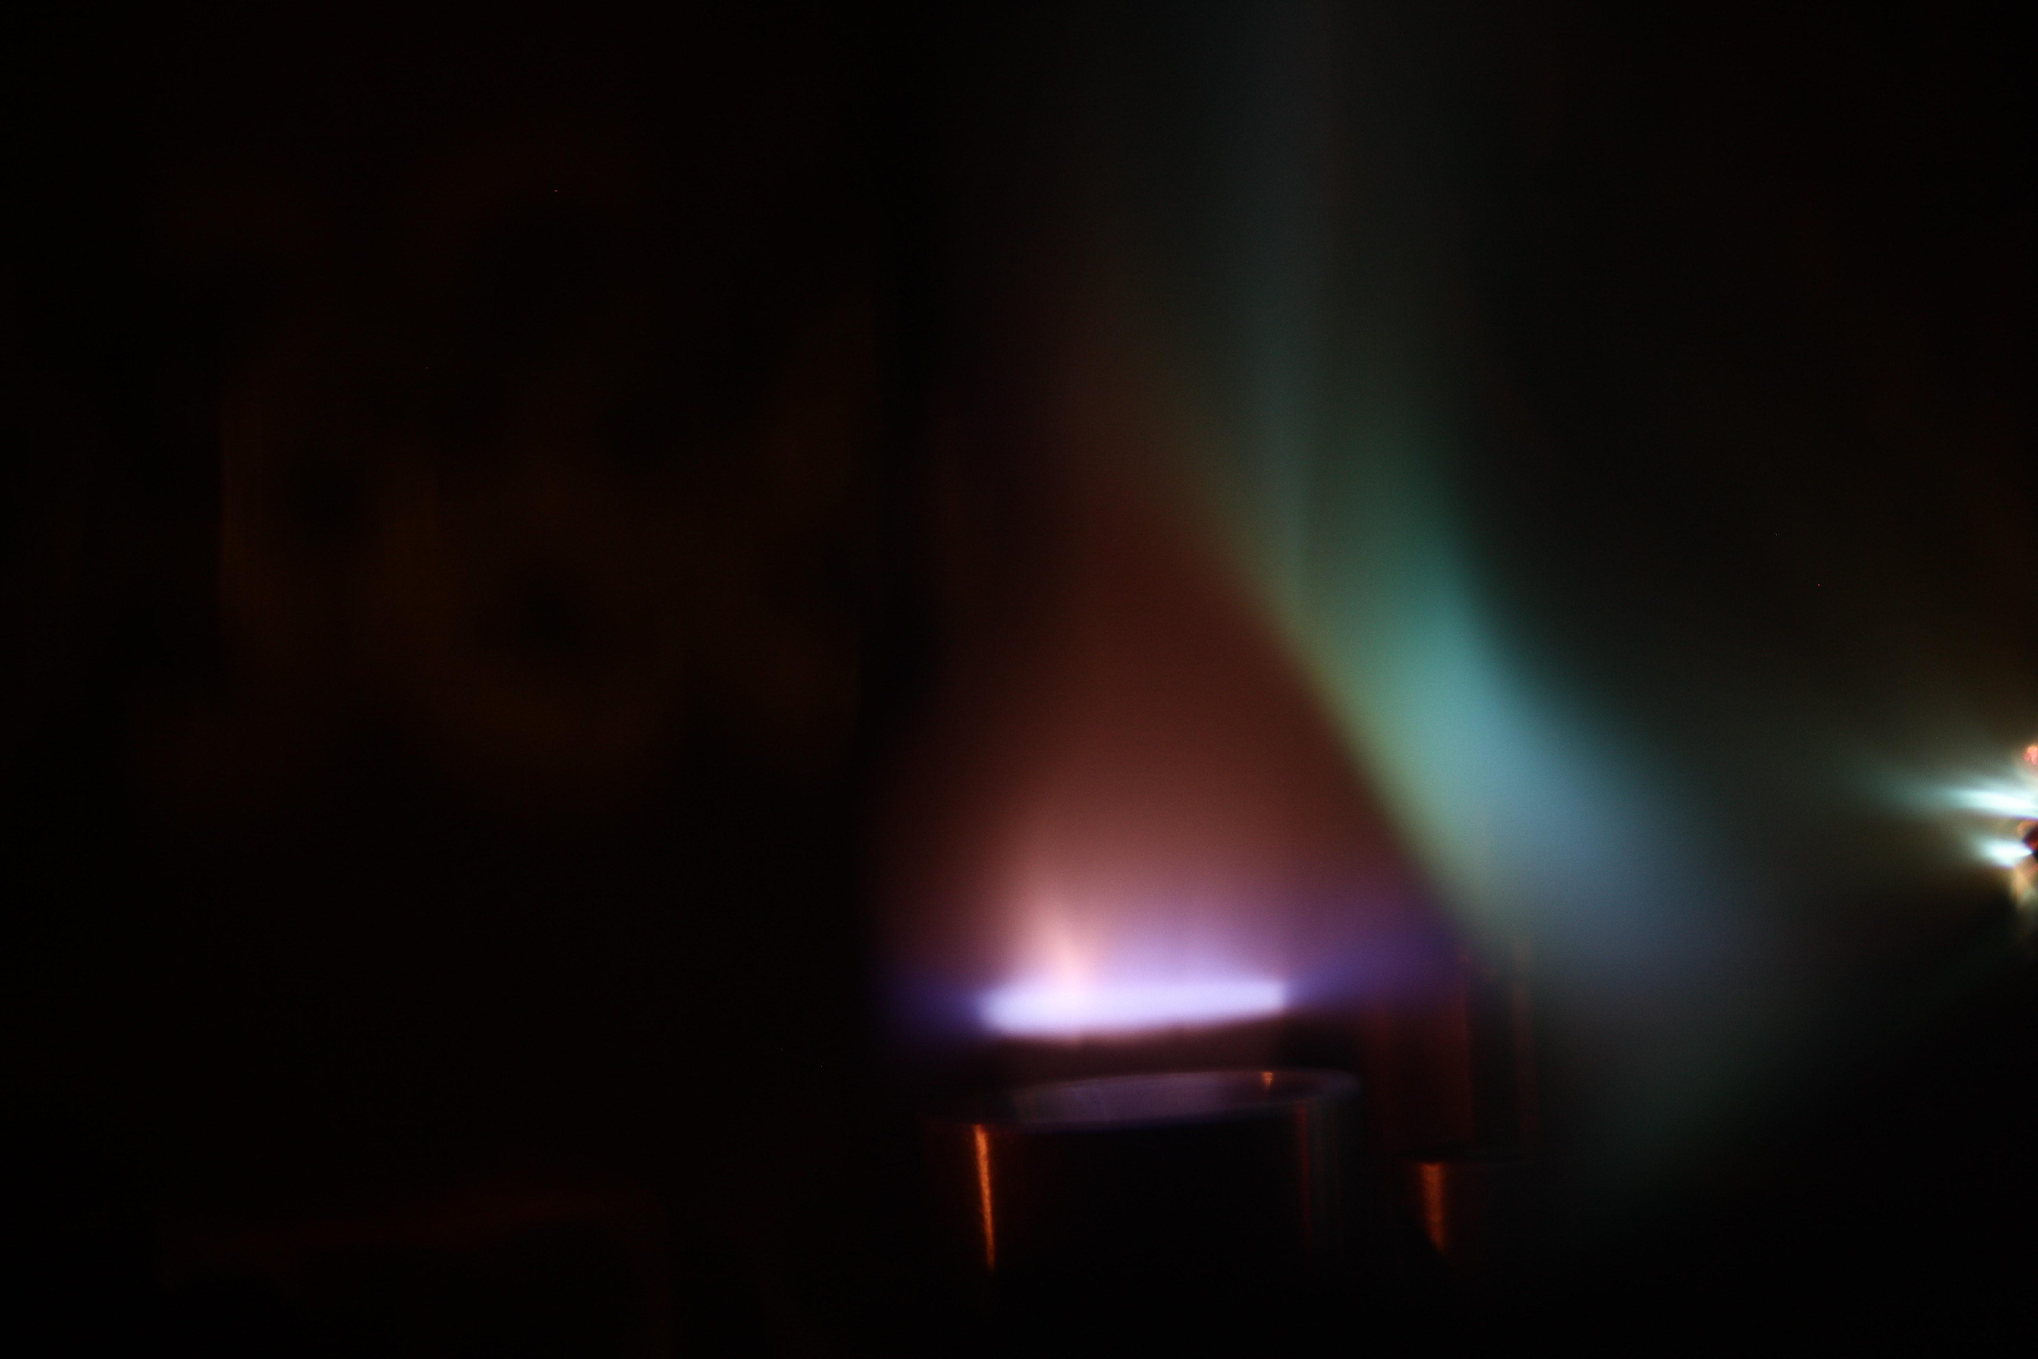
Controlling the dynamics of wakefield accelerators
Matthew Streeter
John Adams Institute for Accelerator Science, Imperial College London

Slide 2

The amplitude of the plasma wave is set by the laser

Slide 3
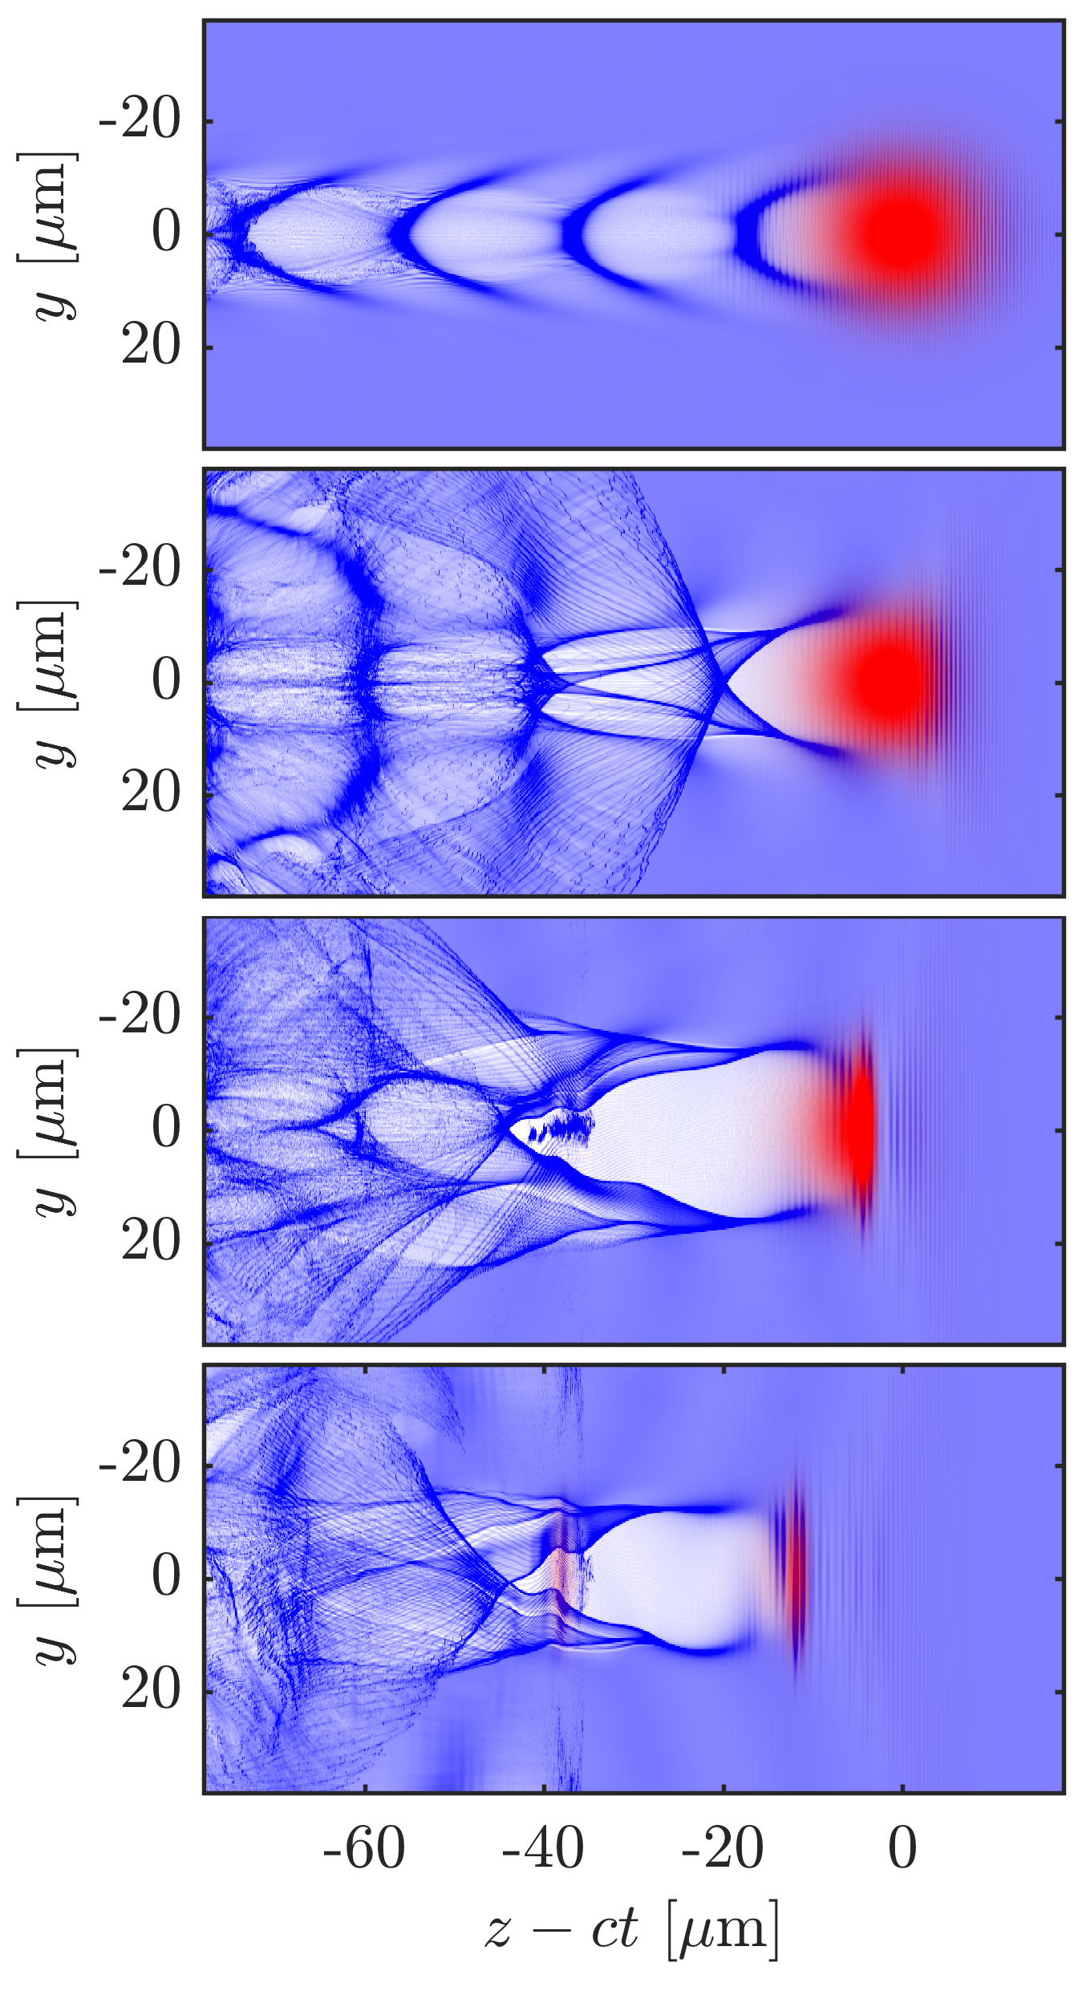
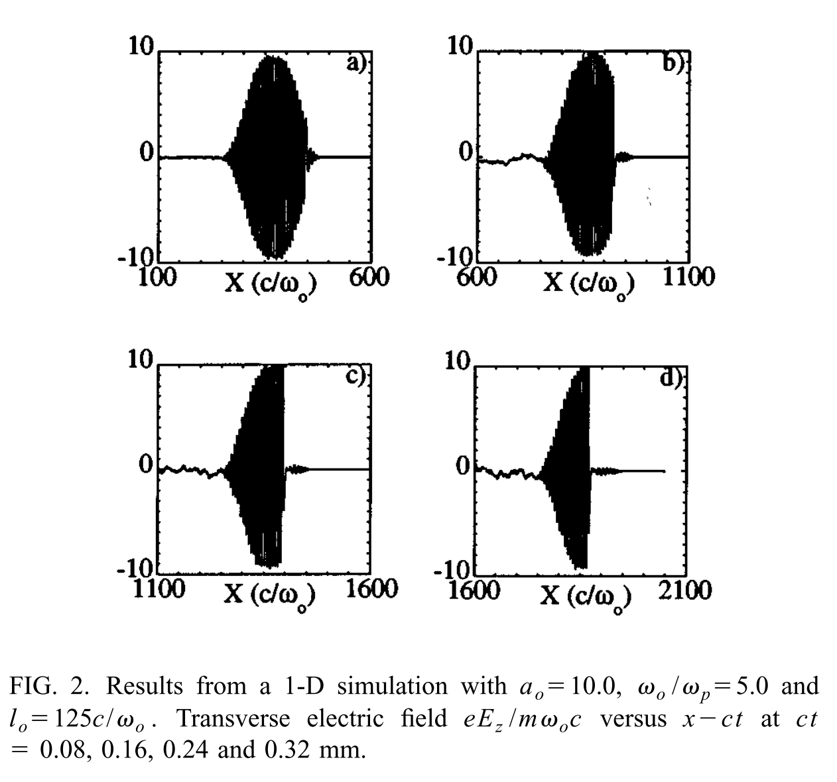
The plasma response modifies the laser pulse
0.0 mm
2.6 mm
5.3 mm
8.0 mm
Decker, C. D. et al. Physics of Plasmas, 3(5) (1996).
Lu, W., et al. Physical Review STAB 10(6), 1–12 (2007).

Slide 5
Longitudinal gradients in refractive index modifies the spectrum of the laser pulse
n_{e}
E
v_{Φ}

Slide 6
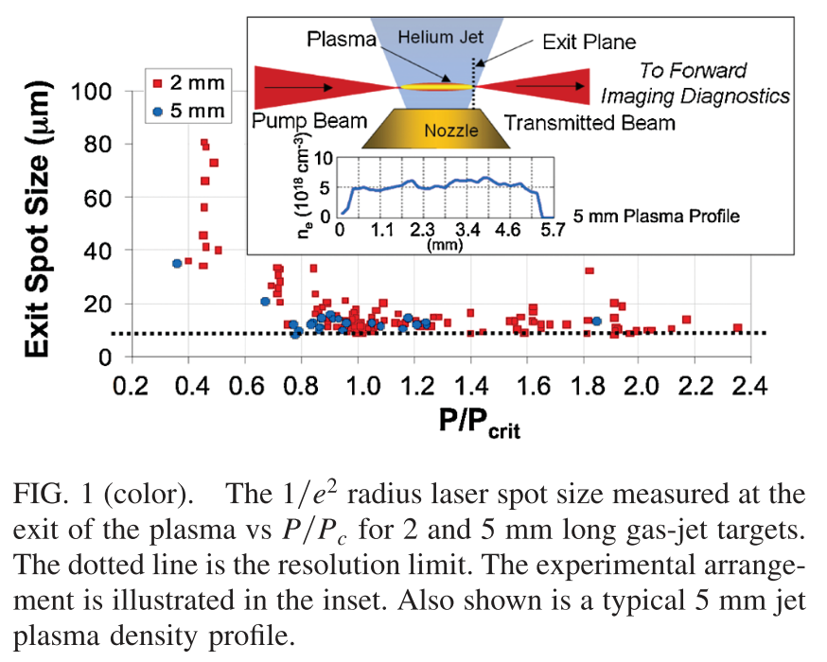
Measurements of self guiding in the blowout regime
Ralph, J. E., et al.. Physical Review Letters, 102(17), 175003. . (2009).

Slide 7
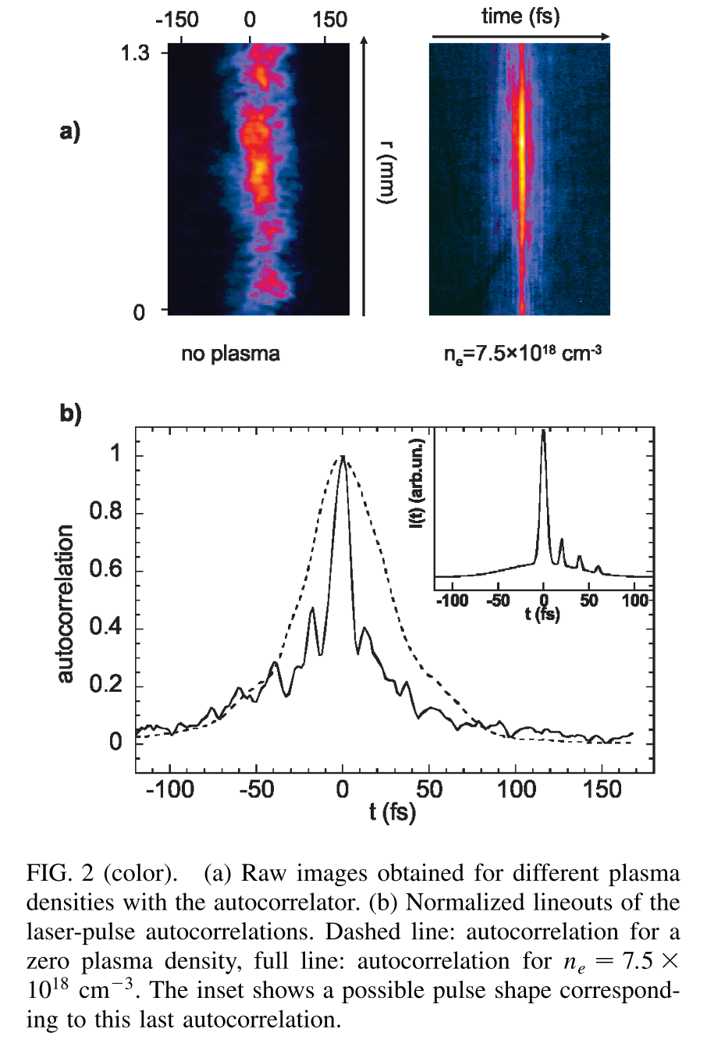
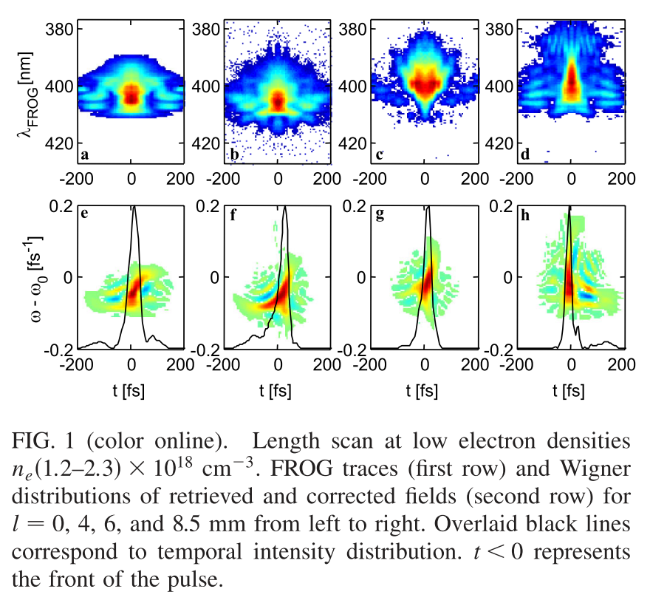
Measurements of pulse compression in non-linear wakefields
Faure, J., et al.. PRL, 95(20), 205003 (2005). Schreiber, J., et al.. PRL, 105(23), 235003 (2010).

Slide 8
An experiment to study laser, electron and x-ray beams simultaneously
Imaging
Transverse probing
Spectrometer
FROG
Laser
12 J, 50 fs,
F/20 focusing
a₀ = 3
Laser diagnostics
Dipole magnet
X-ray
CCD
Helium Gas jet
Electron spectrometer
Plasma channel length = 13 mm

Slide 9
An experiment to study laser, electron and x-ray beams simultaneously
Streeter, M. J. V., et al. (2018) Physical Review Letters, 120(25), 254801. https://doi.org/10.1103/PhysRevLett.120.254801
Bloom, M. S., et al. (2018). https://arxiv.org/abs/1710.05740

Slide 10
An experiment to study laser, electron and x-ray beams simultaneously
Streeter, M. J. V., et al. (2018) Physical Review Letters, 120(25), 254801. https://doi.org/10.1103/PhysRevLett.120.254801
Bloom, M. S., et al. (2018). https://arxiv.org/abs/1710.05740

Slide 11
Depletion length
Dephasing length
Decker, C. D. et al. Physics of Plasmas, 3(5) (1996).
Lu, W., et al. Physical Review STAB 10(6), 1–12 (2007).

Slide 12
Redshifted photons travel slower than the pulse front and cause power amplification
Group velocity of far redshifted photons can be less than the reduced group velocity of the laser
These photons drift backwards and contribute to field behind the depletion region
Pre-Injection Pulse Evolution length
For a Gaussian pulse=:

Slide 13
Laser evolution determines self-injection and acceleration behavior
Model of laser evolution
Streeter, M. J. V., et al. (2018) Physical Review Letters, 120(25), 254801. https://doi.org/10.1103/PhysRevLett.120.254801

Slide 14
Photon ‘tracking’ with PIC code data
a) Photon longitudinal position with electric potential in plasma
b) Laser spectrum evolution
FBPIC: Lehe, R., et al.. Computer Physics Communications, 203, 66–82 (2016).

Slide 15
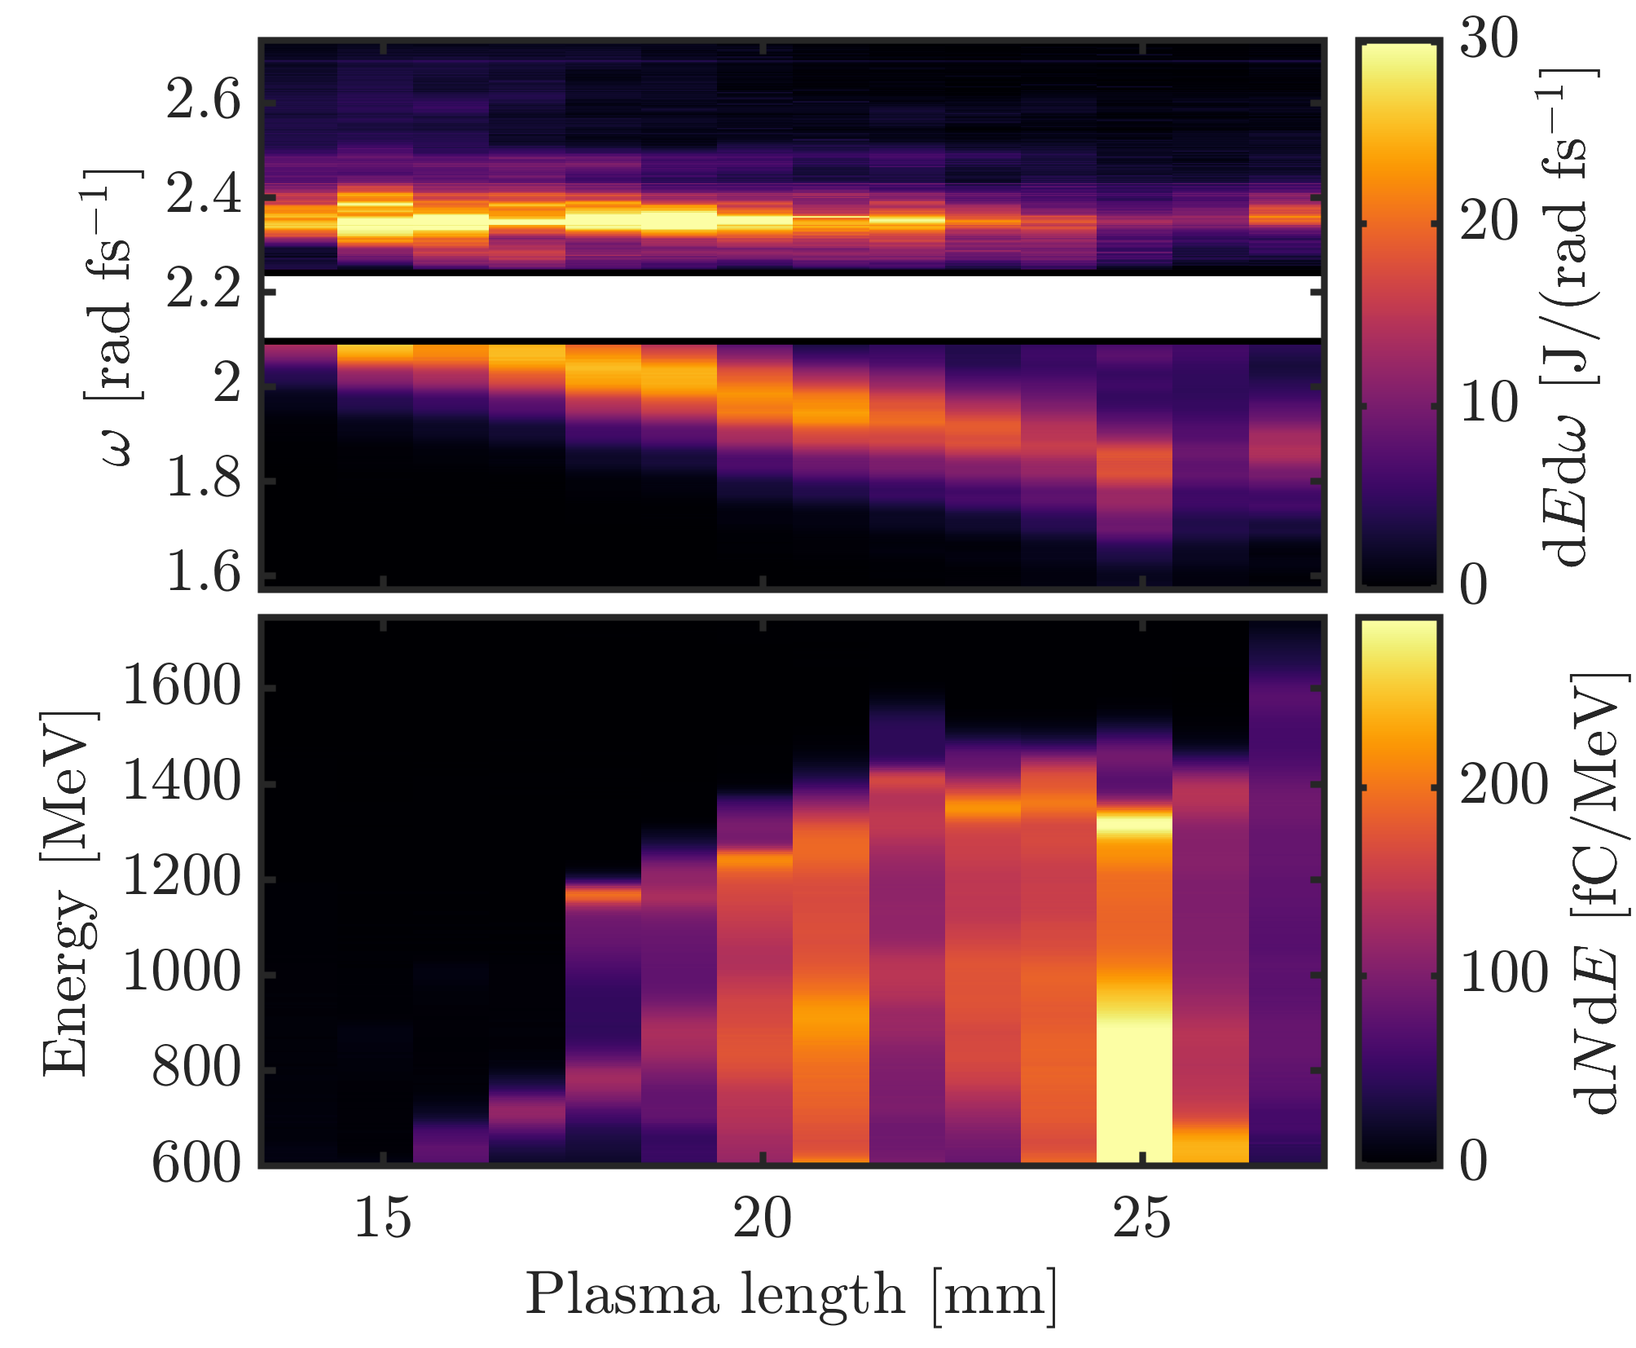
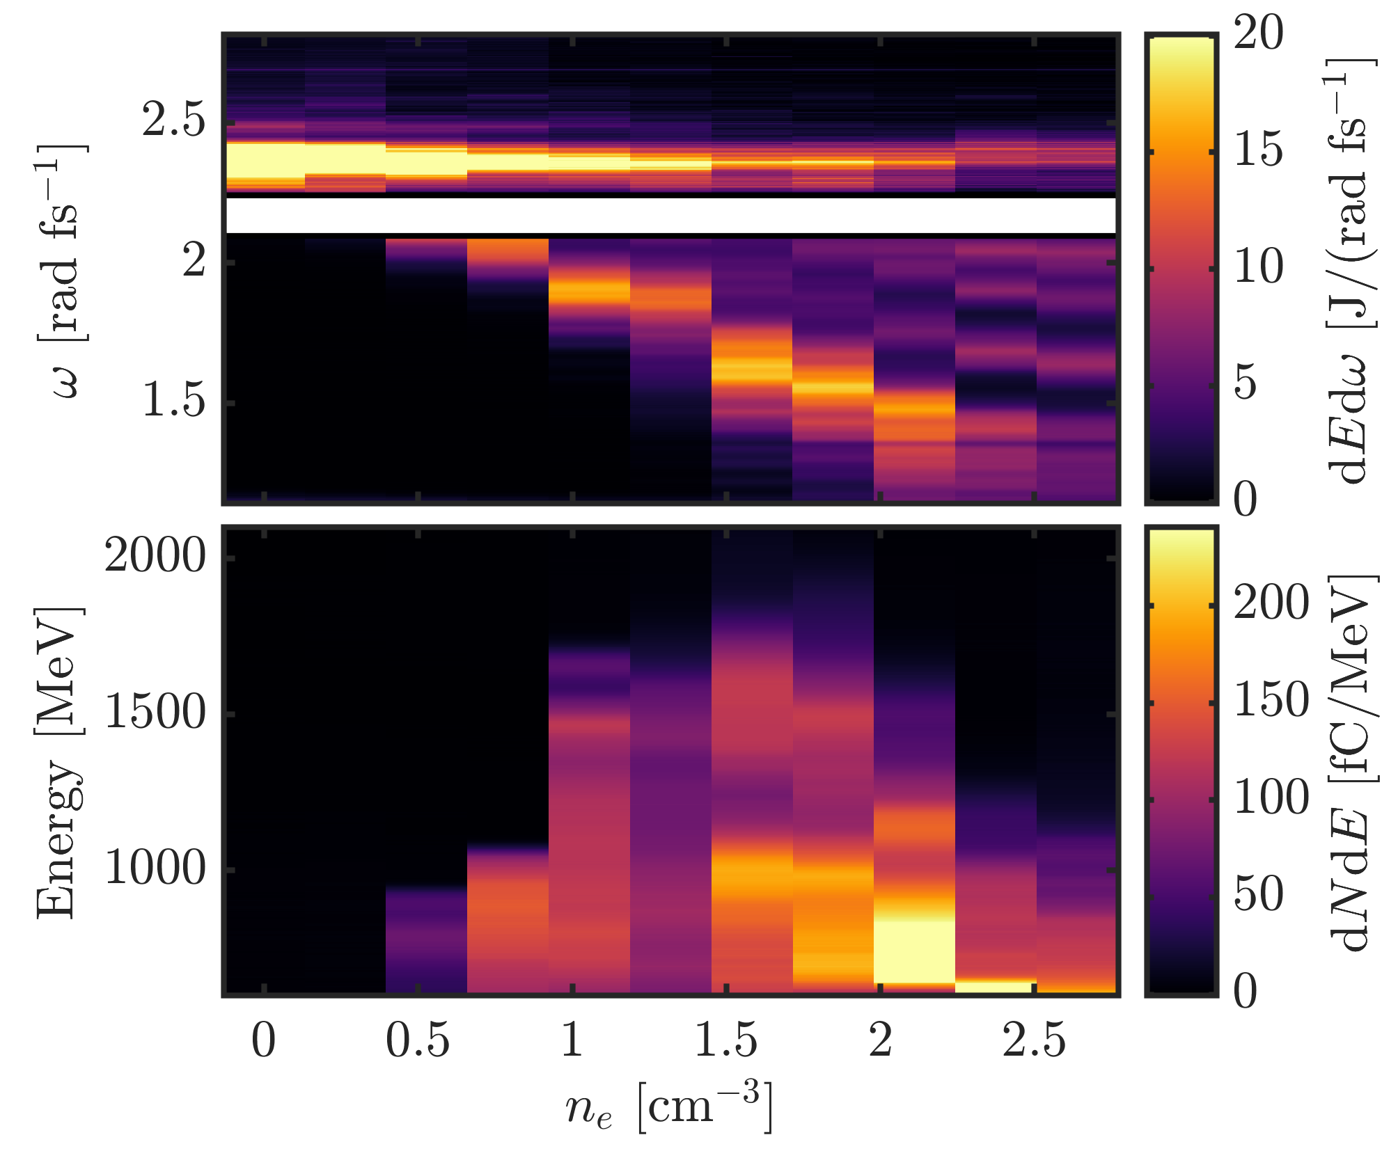
Further experiments confirm the large redshift of the drive laser

Slide 16
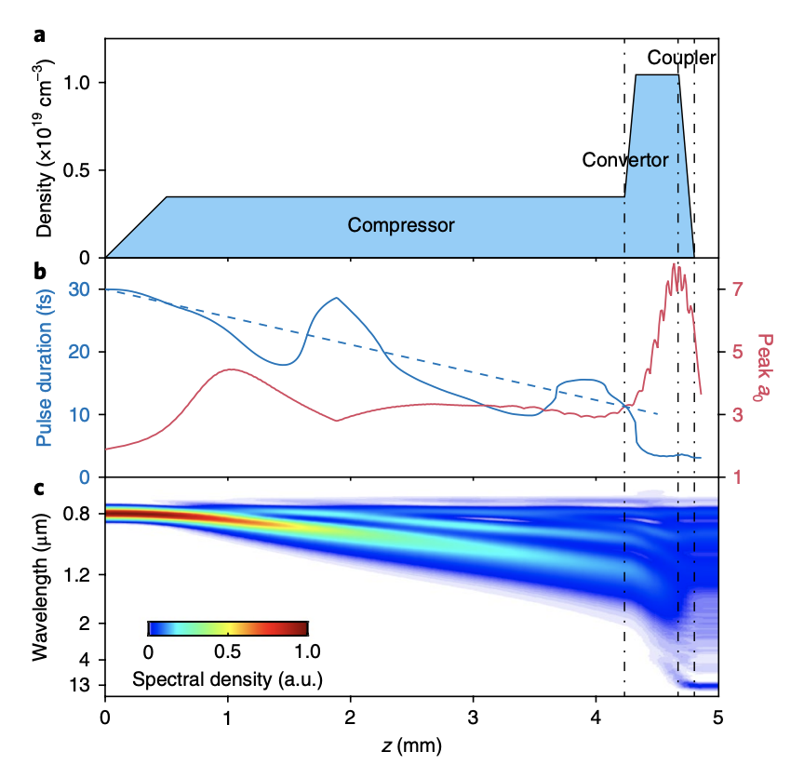
A potential source of powerful single-cycle mid IR pulses
Nie, Z., et al.. Nature Photonics, 12(8), 489–494 (2018).

Slide 17
Controlling the laser evolution by shaping the initial pulse profile
Model prediction
Input laser pulse shapes
1D PIC simulations
Electron density for calculations and simulations

Slide 18
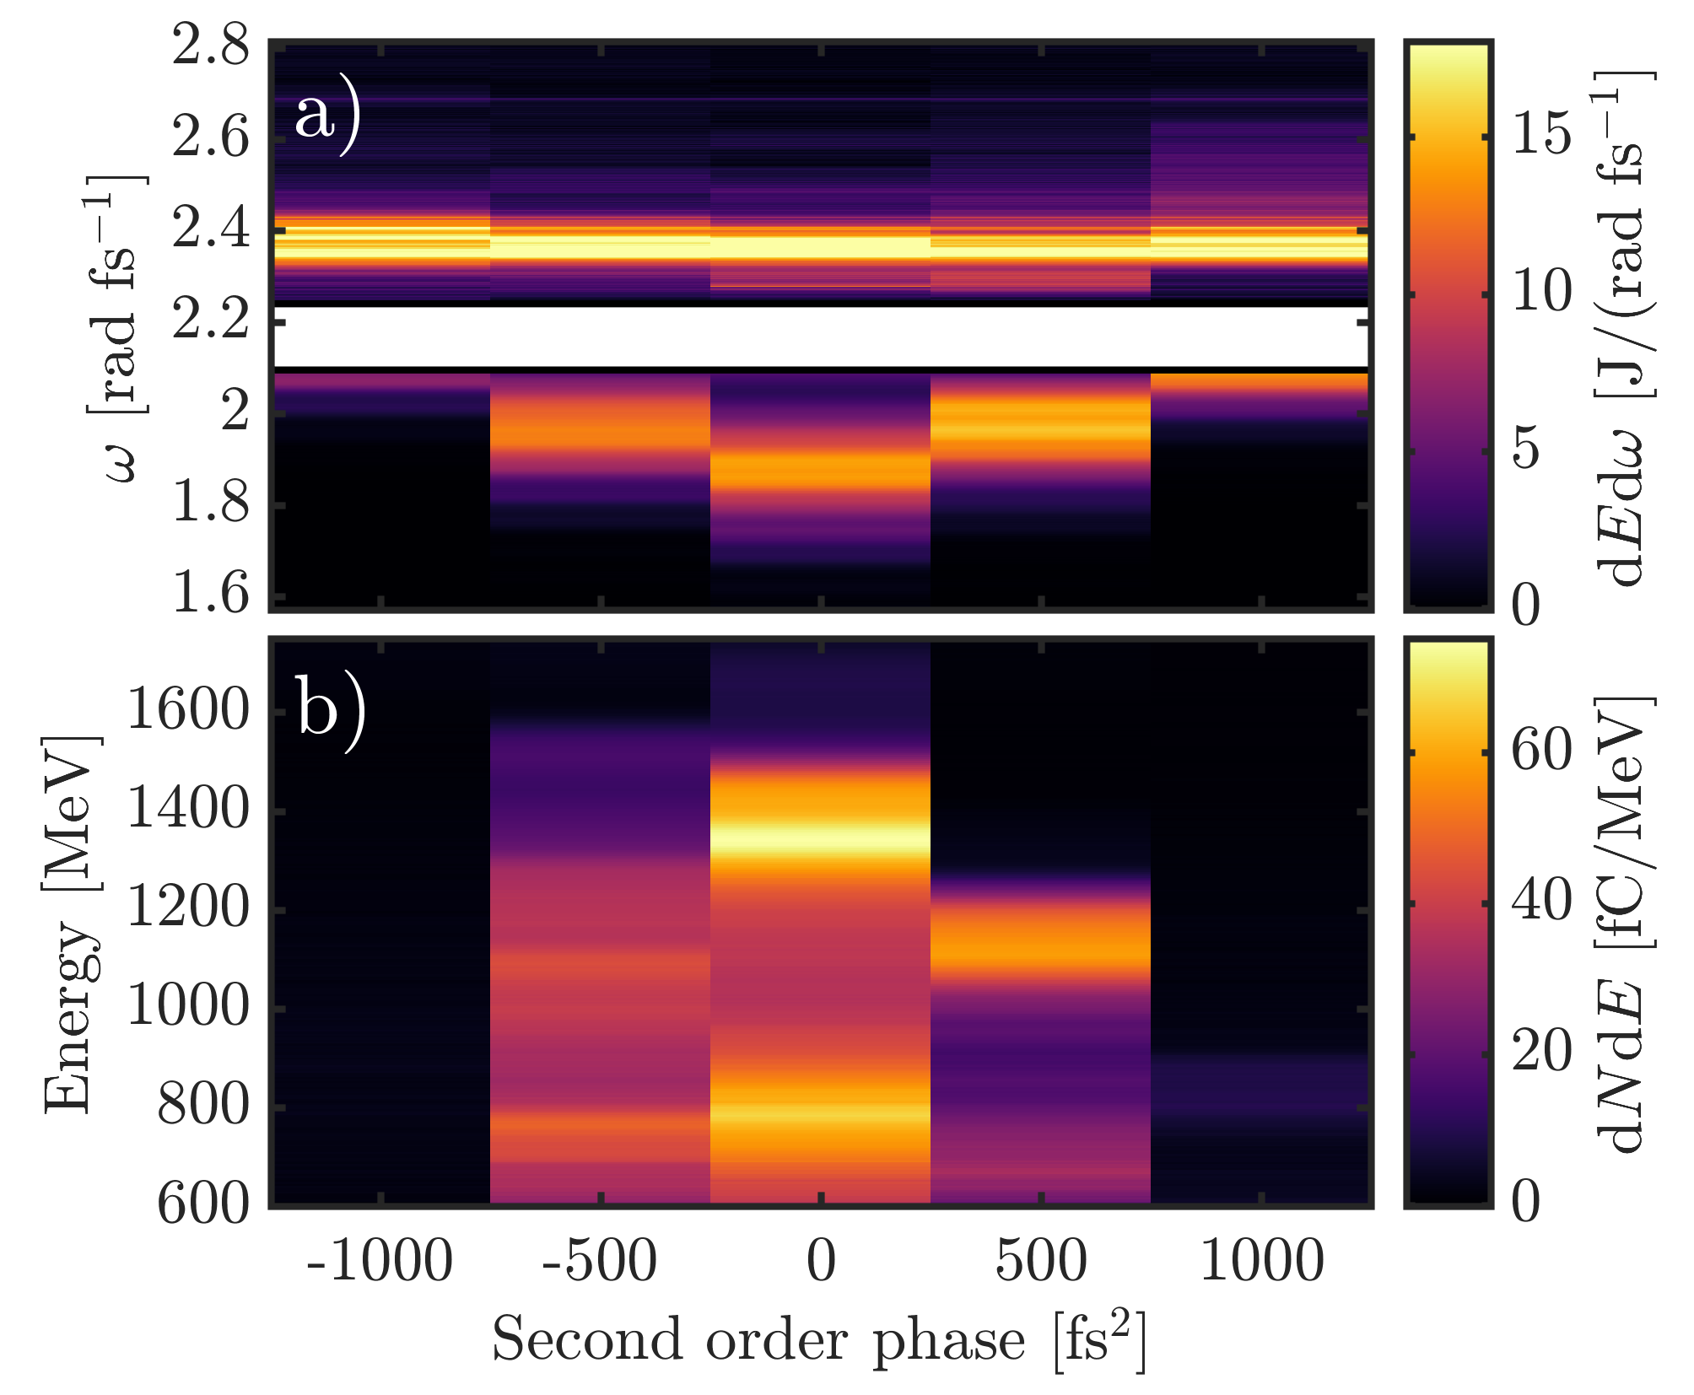
Controlling the laser evolution by shaping the initial pulse profile

Slide 19
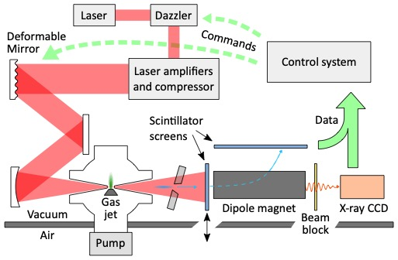
Using active feedback to optimize laser pulse shape
Streeter, M. J. V., et al. Applied Physics Letters, 112(24), 244101 (2018).
Dann, S. J. D. et al Physical Review Accelerators and Beams, 22(4), 041303 (2019).

Slide 20
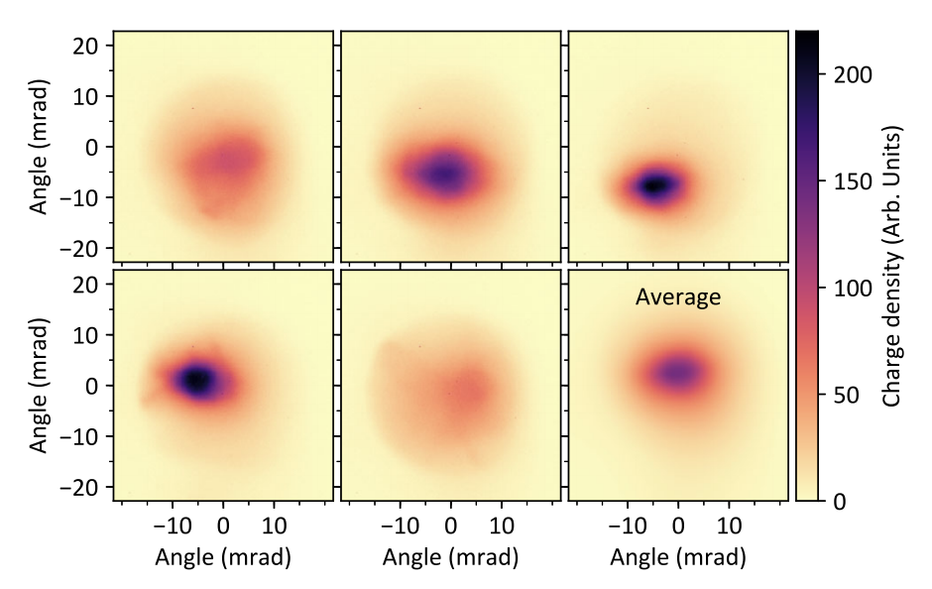
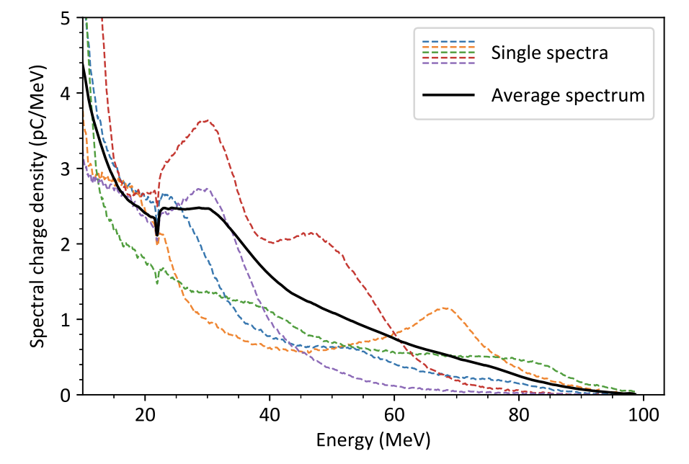
Averaged over 50 shots to obtain results for each setting
Electron beam profile measurements
Electron spectrum measurements
Streeter, M. J. V., et al. Applied Physics Letters, 112(24), 244101 (2018).
Dann, S. J. D. et al Physical Review Accelerators and Beams, 22(4), 041303 (2019).

Slide 21
Algorithm autonomously improved electron spectrum through control of initial pulse shape
Electron spectrum before and after
Fully compressed pulse shape and optimized cases
Streeter, M. J. V., et al. Applied Physics Letters, 112(24), 244101 (2018).
Dann, S. J. D. et al Physical Review Accelerators and Beams, 22(4), 041303 (2019).

Slide 22
Summary
Laser pulse evolution is of central importance to performance of LWFAs
Power amplification leading to self-injection was observed
A phenomenological model of photon acceleration and dispersion was developed to calculate the evolution
Large redshift of the driving laser pulse is observed in highly non-linear LWFA, resulting in octave spanning laser pulses
Control of the input laser pulse shape affects the laser evolution
Machine learning was used to control the input pulse to optimise an LWFA operating at 5 Hz

Slide 23
Thank you

