Slide 1
Quantum Algorithmic Measurement
2101.04634 [Aharonov, Cotler, Qi]
Jordan Cotler
Harvard Society of Fellows
Notes:
QUALM is a “template” in which lab oracle is inputted (among other inputs)

Slide 2
Introduction: what is an experiment?
Measuring constants of nature (speed of light, charge of electron)
Quantifying dynamical properties (rate of a chemical reaction)
Inferring structural properties (symmetry group of a crystal)
Learning more abstract information (the chain of chemical reactions athat comprise photosynthesis, whether Yang-Mills describes the astrong force)

Slide 3
Introduction: what is an experiment?
Measuring constants of nature (speed of light, charge of electron)
Quantifying dynamical properties (rate of a chemical reaction)
Inferring structural properties (symmetry group of a crystal)
Learning more abstract information (the chain of chemical reactions athat comprise photosynthesis, whether Yang-Mills describes the astrong force)
What exactly is an experiment, in its full scope of generality?

Slide 4
Quantum Extended Church-Turing Thesis

Slide 5
Quantum Extended Church-Turing Thesis
A universal quantum computer can efficiently simulate any physical system

Slide 6
Q: Is an experiment a type of algorithm?
Q: What is the complexity of an experiment?
Q: Can tools from quantum algorithms speed up experiments?
Q: Is there a provable advantage of coherent vs. incoherent apparatus?

Slide 7
Q: Is an experiment a type of algorithm?
Q: What is the complexity of an experiment?
Q: Can tools from quantum algorithms speed up experiments?
Q: Is there a provable advantage of coherent vs. incoherent apparatus?
We will address these questions as well as establish a new kind of exponential advantage for quantum experiments

Slide 8
Would like to abstract the notion of an experiment

Slide 9
Would like to abstract the notion of an experiment

Slide 10
Would like to abstract the notion of an experiment

Slide 11
Would like to abstract the notion of an experiment
Interaction between nature and lab
Interaction between lab and working space

Slide 12
Would like to abstract the notion of an experiment
Interaction between nature and lab
Interaction between lab and working space
An experiment is a hybrid of a black box algorithm and interactive protocol

Slide 13

Would like to abstract the notion of an experiment
Interaction between nature and lab
Interaction between lab and working space
An experiment is a hybrid of a black box algorithm and interactive protocol

Slide 14
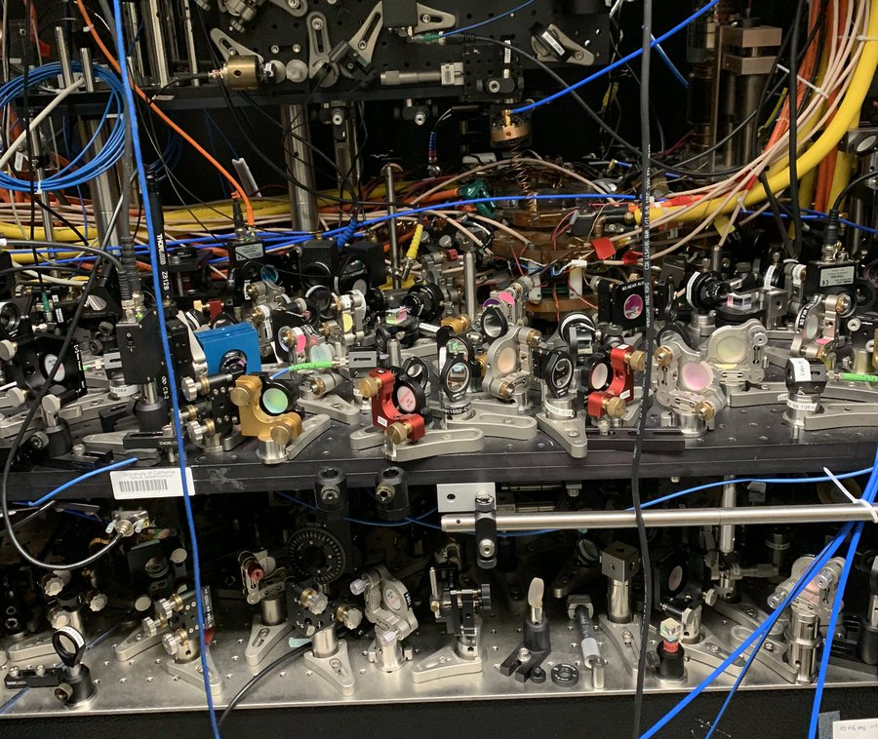
Would like to abstract the notion of an experiment
Interaction between nature and lab
Interaction between lab and working space
An experiment is a hybrid of a black box algorithm and interactive protocol

Slide 15

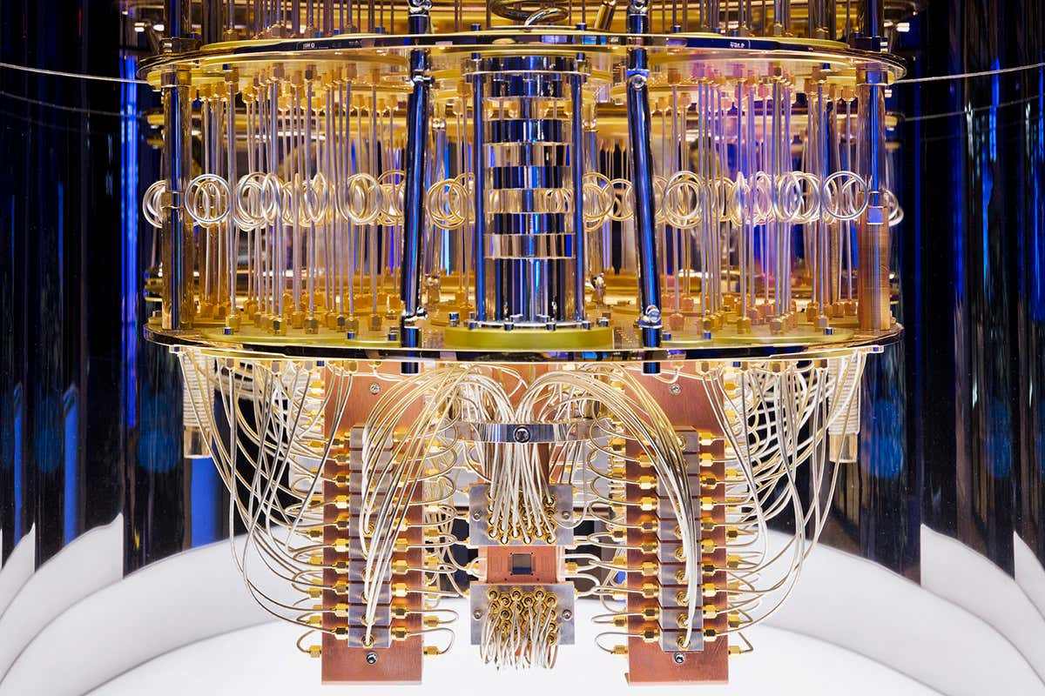
Would like to abstract the notion of an experiment
Interaction between nature and lab
Interaction between lab and working space
An experiment is a hybrid of a black box algorithm and interactive protocol

Slide 16
Would like to abstract the notion of an experiment
Interaction between nature and lab
Interaction between lab and working space
An experiment is a hybrid of a black box algorithm and interactive protocol

Slide 17
Would like to abstract the notion of an experiment
An experiment is a hybrid of a black box algorithm and interactive protocol

Slide 18
Would like to abstract the notion of an experiment
Outputs
Inputs
An experiment is a hybrid of a black box algorithm and interactive protocol

Slide 19
Would like to abstract the notion of an experiment
Outputs
Inputs
An experiment is a hybrid of a black box algorithm and interactive protocol
Three definitions: Lab oracle, QUALM, Task

Slide 20
Would like to abstract the notion of an experiment
Outputs
Lab oracle
Inputs
An experiment is a hybrid of a black box algorithm and interactive protocol
Three definitions: Lab oracle, QUALM, Task

Slide 21
Would like to abstract the notion of an experiment
Outputs
Quantum Algorithmic Measurement
Lab oracle
Inputs
An experiment is a hybrid of a black box algorithm and interactive protocol
Three definitions: Lab oracle, QUALM, Task

Slide 22
Would like to abstract the notion of an experiment
Outputs
Quantum Algorithmic Measurement
Lab oracle
Inputs
QUALM(Lab Oracle, Inputs) $=$ Outputs

Slide 23
Would like to abstract the notion of an experiment
Outputs
Quantum Algorithmic Measurement
Lab oracle
Inputs
QUALM(Lab Oracle, Inputs) $=$ Outputs
A Task is a problem specification, i.e. specifies what we want the QUALM to do

Slide 24
Example 1: X-ray diffraction
Outputs
Inputs

Slide 25
Example 1: X-ray diffraction
Outputs
Inputs

Slide 26
Example 1: X-ray diffraction
Outputs

Slide 27
Example 1: X-ray diffraction
Outputs

Slide 28
Example 1: X-ray diffraction
Outputs
Lab oracle

Slide 29
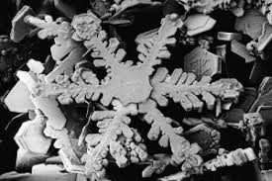
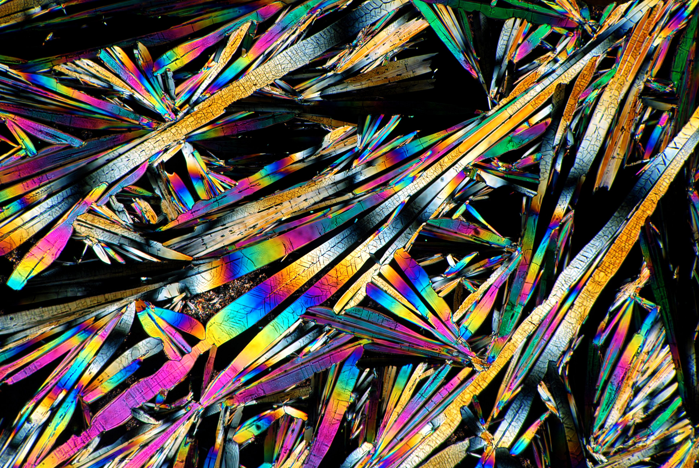
Example 1: X-ray diffraction
Outputs
Lab oracle
Lab oracles: , , …

Slide 30
Example 1: X-ray diffraction
Outputs
Lab oracle
Lab oracles: , , …

Slide 31


Example 1: X-ray diffraction
Outputs
Contains:
detectors,
laser, laptop,…
Lab oracle
Lab oracles: , , …

Slide 32
Example 1: X-ray diffraction
Task is to find shape of a crystal
Outputs
Contains:
detectors,
laser, laptop,…
Lab oracle
Lab oracles: , , …

Slide 33
Example 1: X-ray diffraction
Task is to find shape of a crystal
Outputs
X-ray diffraction is QUALM achieving the Task
Contains:
detectors,
laser, laptop,…
Lab oracle
Lab oracles: , , …

Slide 34
Example 2: Distinguishing two states
Outputs
Inputs

Slide 35
Example 2: Distinguishing two states
Outputs
✓
Inputs

Slide 36
Example 2: Distinguishing two states
Outputs

Slide 37
Example 2: Distinguishing two states
Outputs

Slide 38
Example 2: Distinguishing two states
Outputs
Lab oracle

Slide 39
Example 2: Distinguishing two states
Outputs
Lab oracle
Two possible lab oracles:

Slide 40


Example 2: Distinguishing two states
Outputs
Lab oracle
$$LO_{0}$$
$$LO_{1}$$
Two possible lab oracles: and

Slide 41
Example 2: Distinguishing two states
Outputs
Lab oracle
$$LO_{0}$$
$$LO_{1}$$
Two possible lab oracles: and
Task is to find a QUALM satisfying: QUALM($LO_{0}$) = 0, QUALM($LO_{1}$) = 1

Slide 42
Example 3: Quantum algorithms
Outputs
Inputs

Slide 43
Example 3: Quantum algorithms
Outputs
Inputs

Slide 44
Other examples:

Slide 45
Other examples: We believe that all known and possible experiments fit into aaaaaaaaaaaaaaathis paradigm

Slide 46
Other examples: We believe that all known and possible experiments fit into aaaaaaaaaaaaaaathis paradigm
Quantum algorithms, quantum state tomography, quantum Hamiltonian tomography, quantum verification protocols, quantum process tomography, quantum cooling protocols, quantum machine learning, quantum communication protocols, Gibbs sampling, quantum imaging, quantum control theory,…

Slide 47
Other examples: We believe that all known and possible experiments fit into aaaaaaaaaaaaaaathis paradigm
Quantum algorithms, quantum state tomography, quantum Hamiltonian tomography, quantum verification protocols, quantum process tomography, quantum cooling protocols, quantum machine learning, quantum communication protocols, Gibbs sampling, quantum imaging, quantum control theory,…
We will see that the QUALM framework helps us to analyze experiments using tools from quantum complexity theory and to ask new questions; the generality of the framework inspires new and novel experiments

Slide 48
A quantum circuit point of view
We write out the circuit in spacetime and can see the application of the lab oracle which couples Nature and the lab, as well as the quantum circuits which couple the lab and the working space
Data of the lab oracle includes the superoperator and the initial state of Nature
Data of the QUALM includes the quantum circuits acting jointly on the lab and working space

Slide 49
Complexity of a QUALM

Slide 50
Complexity of a QUALM

Slide 51
Complexity of a QUALM
A combination of computational complexity and query complexity
Our analyses will combine techniques from each type of complexity theory

Slide 52
Complexity of a Task
The complexity of a Task is the minimum complexity over QUALMs achieving that Task
Quantifies the minimal resources required to achieve the Task

Slide 53
Types of access
How is information communicated between the lab and working space?
N
L
W

Slide 54
Types of access
How is information communicated between the lab and working space?
Coherent access:
Information communicated by quantum channel
Incoherent access:
Information communicated by classical channel a(i.e., via LOCC’s)
Lab system completely measured between lab aoracle accesses
N
L
W

Slide 55
Types of access
How is information communicated between the lab and working space?
Coherent access:
Information communicated by quantum channel
Quantum memory
Quantum computation on stored quantum data
Incoherent access:
Information communicated by classical channel a(i.e., via LOCC’s)
Lab system completely measured between lab aoracle accesses
No quantum memory
Quantum computation on stored classical data
Can still employ adaptive strategies

Slide 56
Complexity of a Task with specified access type

Slide 57
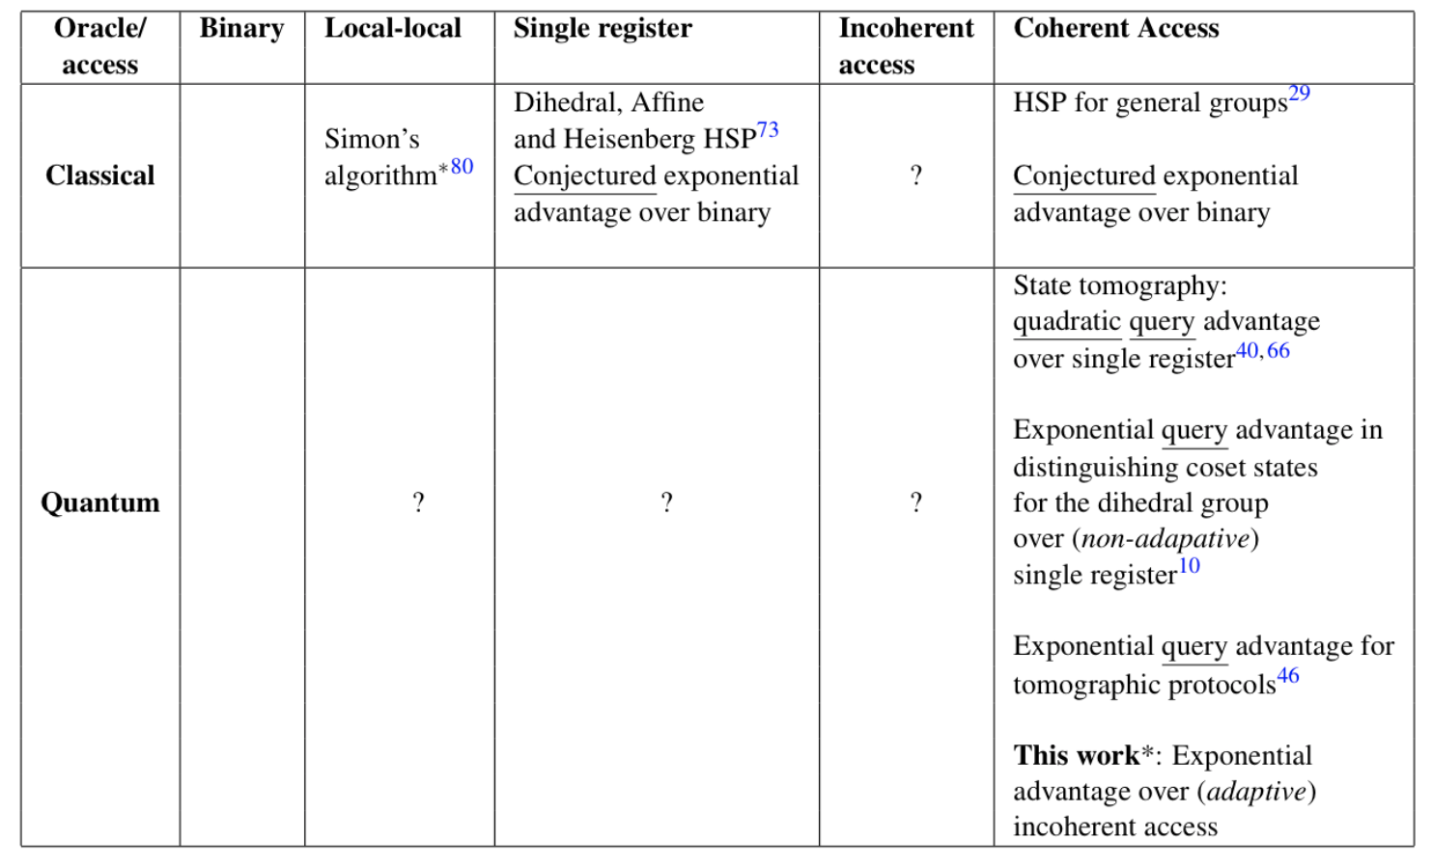
Other access types
Notes:
Other types of access

Slide 58
QUALM complexity advantage is physically important!
Other access types
Notes:
Other types of access

Slide 59
QUALM complexity advantage is physically important!
Other access types
[Bacon, Childs, van Dam ‘05]
[Huang, Kueng, Preskill ‘21]
Notes:
Other types of access

Slide 60
QUALM complexity advantage is physically important!
Other access types
[Bacon, Childs, van Dam ‘05]
[Huang, Kueng, Preskill ‘21]
Notes:
Other types of access

Slide 61
A comment on Simon’s algorithm
Simon’s algorithm sits within the non-adaptive, incoherent access setting
The quantum algorithm only requires the experimentalist to prepare product states and make product measurements
Accordingly, Simon’s algorithm provides an exponential advantage of non-adaptive, incoherent access QUALMS over classical QUALMs
By contrast, our work is concerned with an exponential advantage of coherent access QUALMs over adaptive, incoherent access QUALMs
Notes:
Other types of access

Slide 62
QUALM hierarchy
Adaptive, incoherent access
Non-adaptive, incoherent access
Coherent access
Classical
Notes:
Other types of access

Slide 63
QUALM hierarchy
Adaptive, incoherent access
Non-adaptive, incoherent access
Coherent access
Classical
Exponential advantage due to [Aharonov, Cotler, Qi ‘21]
Exponential advantage due to Simon’s algorithm
Notes:
Other types of access

Slide 64
Fixed unitary problem
Intuition: It is difficult to distinguish time-independent evolution from time-aaaaaaaaidependent evolution if each is sufficiently chaotic
We will make this intuition precise by first formulating a Task.

Slide 65
Fixed unitary problem
Outputs
Inputs

Slide 66
Fixed unitary problem
Outputs
✓
Inputs

Slide 67
Fixed unitary problem
Outputs

Slide 68
Fixed unitary problem
Outputs

Slide 69
Fixed unitary problem
Outputs

Slide 70
Fixed unitary problem
Outputs
Lab oracle

Slide 71

Fixed unitary problem
Outputs
Lab oracle
$$LO_{0}$$
$$LO_{1}$$
Two lab oracles: and

Slide 72
Fixed unitary problem
Outputs
Lab oracle
Haar-random, same each time
i.i.d. Haar-random
$$LO_{0}$$
$$LO_{1}$$
Two lab oracles: and

Slide 73
Fixed unitary problem
Outputs
Lab oracle
Haar-random, same each time
i.i.d. Haar-random
$$LO_{0}$$
$$LO_{1}$$
Two lab oracles: and
Task is to find a QUALM satisfying: QUALM($LO_{0}$) = 0, QUALM($LO_{1}$) = 1

Slide 74
Fixed unitary problem
Notes:
Find an example vs. rule out all possible examples!

Slide 75
Fixed unitary problem
Theorem [Aharonov, Cotler, Qi ‘21]
Notes:
Find an example vs. rule out all possible examples!

Slide 76
Fixed unitary problem
Theorem [Aharonov, Cotler, Qi ‘21]
Establishes an exponential separation between coherent access and incoherent access
A new kind of exponential separation in quantum complexity theory
Notes:
Find an example vs. rule out all possible examples!

Slide 77
Fixed unitary problem
Theorem [Aharonov, Cotler, Qi ‘21]
Linear upper bound on coherent access task complexity: Easy
Just find a single coherent access QUALM that works
Exponential lower bound on incoherent access task complexity: Hard
Need to rule out all efficient incoherent access QUALMs (!!)
Notes:
Find an example vs. rule out all possible examples!

Slide 78
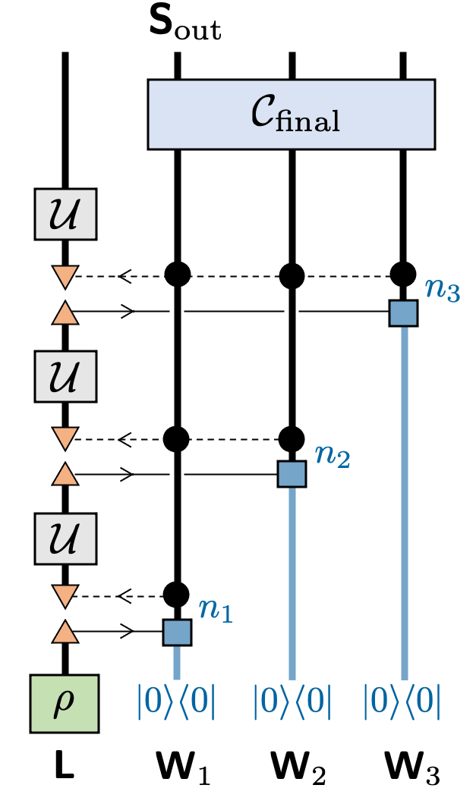
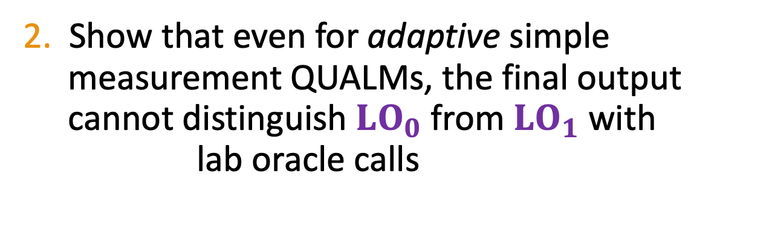
Fixed unitary problem
Lower bounding incoherent access QUALMs
Sketch of proof:
1. Reduce to analyzing “simple measurement aaiQUALMS” (single measurement and single aaipreparation between each lab oracle call)
2. Show that even for adaptive simple aaimeasurement QUALMs, the final output aaicannot distinguish $LO_{0}$ from $LO_{1}$ with aai. lab oracle calls
Notes:
Find an example vs. rule out all possible examples!

Slide 79
Fixed unitary problem
Lower bounding incoherent access QUALMs
Sketch of proof:
1. Reduce to analyzing “simple measurement aaiQUALMS” (single measurement and single aaipreparation between each lab oracle call)
2. Show that even for adaptive simple aaimeasurement QUALMs, the final output aaicannot distinguish $LO_{0}$ from $LO_{1}$ with aai. lab oracle calls
Uses techniques from representation theory, combinatorics, and random matrix theory (particularly Weingarten functions)
Notes:
Find an example vs. rule out all possible examples!

Slide 80
Symmetry distinction problem

Slide 81
Symmetry distinction problem
Intuition: It is difficult to determine the symmetry classes of a strongly-aaaaaaaiiiinteracting quantum many-body system
We formulate a Task in which this can be made precise.

Slide 82
Symmetry distinction problem
Intuition: It is difficult to determine the symmetry classes of a strongly-aaaaaaaiiiinteracting quantum many-body system
We formulate a Task in which this can be made precise
First, recall time-reversal symmetry classes of unitaries:
Unitary
Orthogonal
Symplectic

Slide 83
Symmetry distinction problem
Outputs

Slide 84
Symmetry distinction problem
Outputs

Slide 85
Symmetry distinction problem
Outputs
Lab oracle

Slide 86


Symmetry distinction problem
Outputs
Lab oracle
Lab oracles:
$$LO_{0}$$
$$LO_{1}$$
$$LO_{2}$$

Slide 87
Symmetry distinction problem
Outputs
Lab oracle
Haar-random, same each time
Lab oracles:
$$LO_{0}$$
$$LO_{1}$$
$$LO_{2}$$

Slide 88
Symmetry distinction problem
Outputs
Lab oracle
Haar-random, same each time
Lab oracles:
$$LO_{0}$$
$$LO_{1}$$
$$LO_{2}$$
Task to find QUALM satisfying: QUALM($LO_{0}$) = 0, QUALM($LO_{1}$) = 1, QUALM($LO_{2}$) = 2

Slide 89
Symmetry distinction problem
Theorem [Aharonov, Cotler, Qi ‘21]
Notes:
Find an example vs. rule out all possible examples!

Slide 90
Symmetry distinction problem
Theorem [Aharonov, Cotler, Qi ‘21]
Linear upper bound on coherent access task complexity: Easy (but interesting)
Find a single coherent access QUALM that works
Exponential lower bound on incoherent access task complexity: Hard
Rule out all efficient incoherent access QUALMs
Notes:
Find an example vs. rule out all possible examples!

Slide 91
Discussion
Quantum computers better than classical computers at classical problems
Quantum supremacy

Slide 92
Discussion
Quantum computers better than classical computers at classical problems
Quantum supremacy
Quantum coherence has advantage over incoherence for quantum experiments
QUALM supremacy

Slide 93
Discussion
We have established a new framework for analyzing quantum experiments using quantum complexity theory; opens up a whole new set of questions
We have established that coherent coupling between experimental apparatus and a quantum computer can lead to exponential savings in resources
Experimental demonstration of QUALM advantage in the NISQ era?
What are effects of noise?
Other, more physical examples with coherent QUALM advantage?

