Slide 1
Distributed Quantum Proofs for Replicated Data
arXiv: 2002.10018
Proc. ITCS2021
Pierre Fraigniaud (CNRS/U de Paris)
Francois Le Gall, Harumichi Nishimura (Nagoya U)
Ami Paz (U Wien)
February 5th, 2021
QIP2021

Slide 2


Quantum Distributed Computing
Leader election [Tani, Kobayashi, Matsumoto 05, 09]
Byzantine agreement [Ben-Or, Hassidim 05]
Diameter [Le Gall, Magniez 18]
All pairs shortest paths [Izumi, Le Gall 19]
Triangle finding [Izumi, Le Gall, Magniez 20]
etc

Slide 3
Outline
Problem (Equality of data on networks)
Setting (Distributed Merlin-Arthur protocols)
Results (Quantum dMA protocols)
Overview of our protocol

Slide 4



Our Problem: Equality of Replicated Data
YES
$$x$$
Replicated data on a network
Are all data identical?
$$x$$
$$x$$
terminals (nodes who have data)

Slide 5

Our Problem: Equality of Replicated Data
NO
$$x$$
Replicated data on a network
Are all data identical?
$$x′$$
$$x$$
terminals (nodes who have data)

Slide 6
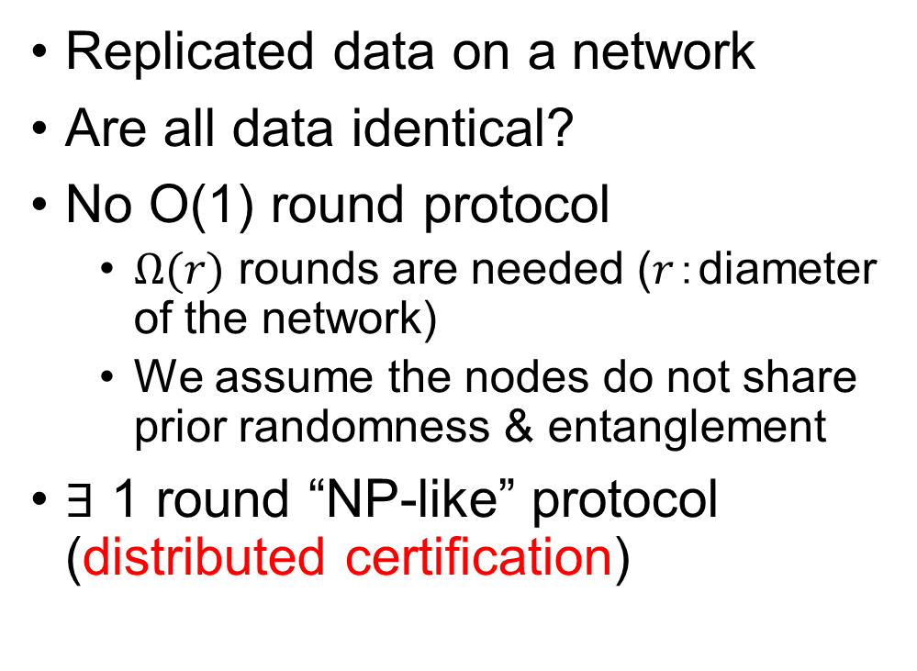


Our Problem: Equality of Replicated Data
Replicated data on a network
Are all data identical?
No O(1) round protocol
  $Ω(r)$ rounds are needed ($r$：diameter of the network)
  We assume the nodes do not share prior randomness & entanglement
$∃$ 1 round “NP-like” protocol (distributed certification)
$$x$$
$$y$$
$$z$$
terminals (nodes who have data)

Slide 7
Outline
Problem (Equality of data on networks)
Setting (Distributed Merlin-Arthur protocols)
Results (Quantum dMA protocols)
Overview of our protocol

Slide 8

Distributed Certification
Verifier (Arthur)
Distributed Merlin-Arthur (dMA) protocols
  Proof labeling scheme [Korman, Kutten, Peleg 10]
  Locally checkable proof [Goos, Suomela 16]
etc
$$x$$
$$y$$
$$W$$
P
Prover (Merlin)
$$z$$

Slide 9


Distributed Certification
$$x$$
Distributed Merlin-Arthur (dMA) protocols
  Proof labeling scheme [Korman, Kutten, Peleg 10]
  Locally checkable proof [Goos, Suomela 16]
etc
$$y$$
$$w$$
$$w′$$
Two phases:
(Prover phase) Prover sends certificates to each node
P
Prover (Merlin)
$$z$$

Slide 10


Distributed Certification
$$x$$
Distributed Merlin-Arthur (dMA) protocols
  Proof labeling scheme [Korman, Kutten, Peleg 10]
  Locally checkable proof [Goos, Suomela 16]
etc
$$y$$
$$w$$
$$w′$$
Two phases:
(Prover phase) Prover sends certificates to each node
(Verification phase) Each node exchanges messages with the neighbors
P
Prover (Merlin)
$$z$$

Slide 11

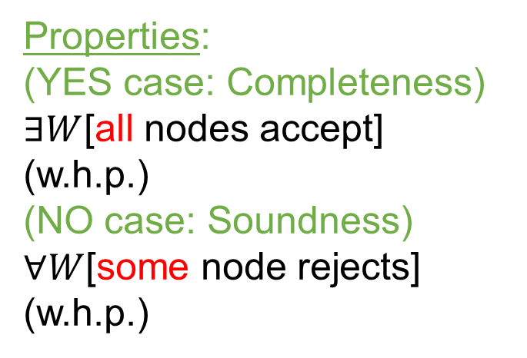

Distributed Certification
$$x$$
Distributed Merlin-Arthur (dMA) protocols
  Proof labeling scheme [Korman, Kutten, Peleg 10]
  Locally checkable proof [Goos, Suomela 16]
etc
$$y$$
Properties:
(YES case: Completeness)
$∃W$[all nodes accept] (w.h.p.)
(NO case: Soundness)
$∀W$[some node rejects]
(w.h.p.)
$$W$$
P
Prover (Merlin)
$$z$$

Slide 12





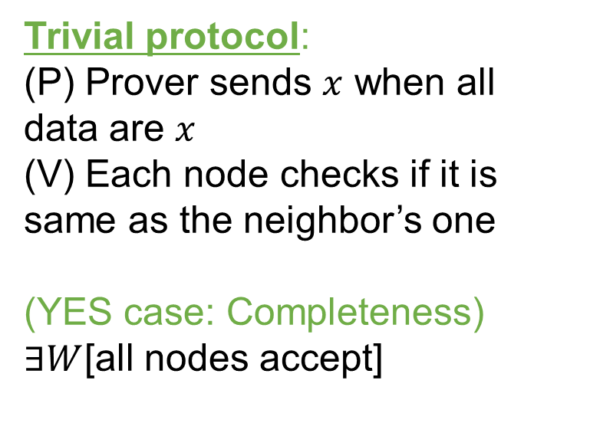


Distributed Certification
$$x$$
Distributed Merlin-Arthur (dMA) protocols
  Proof labeling scheme [Korman, Kutten, Peleg 10]
  Locally checkable proof [Goos, Suomela 16]
etc
$$x$$
$$x$$
$$x$$
Trivial protocol:
(P) Prover sends $x$ when all data are $x$
(V) Each node checks if it is same as the neighbor’s one
(YES case: Completeness)
$∃W$[all nodes accept]
$$x$$
P
$$x$$
$$x$$
Prover (Merlin)
$$x$$
$$x$$
$$x$$

Slide 13


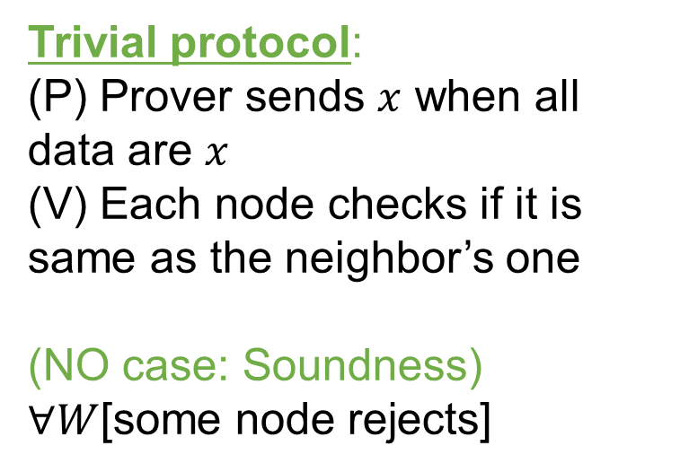

Distributed Certification
$$x$$
Distributed Merlin-Arthur (dMA) protocols
  Proof labeling scheme [Korman, Kutten, Peleg 10]
  Locally checkable proof [Goos, Suomela 16]
etc
$$x$$
$$x$$
$$x′$$
Trivial protocol:
(P) Prover sends $x$ when all data are $x$
(V) Each node checks if it is same as the neighbor’s one
(NO case: Soundness)
$∀W$[some node rejects]
$$x$$
P
$$x$$
$$x$$
Prover (Merlin)
$$x$$
$$x$$
$$x$$

Slide 14
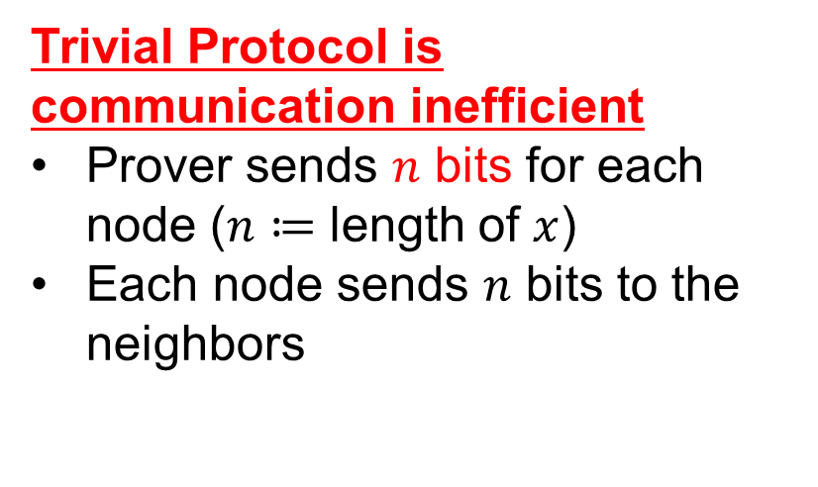

Distributed Certification
$$x$$
Distributed Merlin-Arthur (dMA) protocols
  Proof labeling scheme [Korman, Kutten, Peleg 10]
  Locally checkable proof [Goos, Suomela 16]
etc
$$x$$
$$x$$
$$x′$$
Trivial Protocol is communication inefficient
Prover sends $n$ bits for each node ($n≔$ length of $x$)
Each node sends $n$ bits to the neighbors
$$x$$
P
$$x$$
$$x$$
Prover (Merlin)
$$x$$
$$x$$
$$x$$

Slide 15
Outline
Problem (Equality of data on networks)
Setting (Distributed quantum Merlin-Arthur protocols)
Results (Quantum dMA protocols)
Overview of our protocol

Slide 16


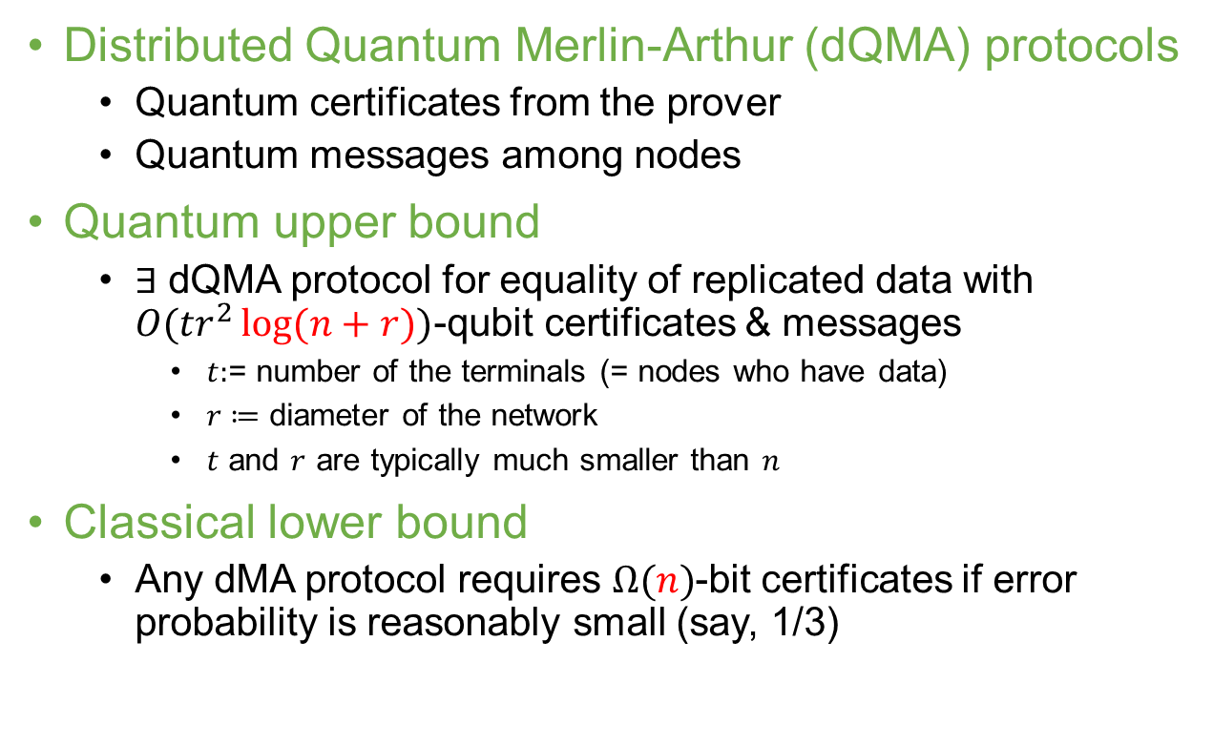



Our Results
Distributed Quantum Merlin-Arthur (dQMA) protocols
  Quantum certificates from the prover
  Quantum messages among nodes
Quantum upper bound
  $∃$ dQMA protocol for equality of replicated data with $O(tr^{2}\log{(n+r)})$-qubit certificates & messages
    $t:$= number of the terminals (= nodes who have data)
    $r≔$ diameter of the network
    $t$ and $r$ are typically much smaller than $n$
Classical lower bound
  Any dMA protocol requires $Ω(n)$-bit certificates if error probability is reasonably small (say, 1/3)
$$x$$
$$|W⟩$$
$$y$$
P
$$|ψ⟩$$
$$z$$

Slide 17
Outline
Problem (Equality of data on networks)
Setting (Distributed quantum Merlin-Arthur protocols)
Results (Quantum dMA protocols)
Overviews of our protocol
  Path networks
  # Our protocol for general networks is obtained by a combination of the protocol for paths and classical dMA protocols such as certifying spanning trees

Slide 18

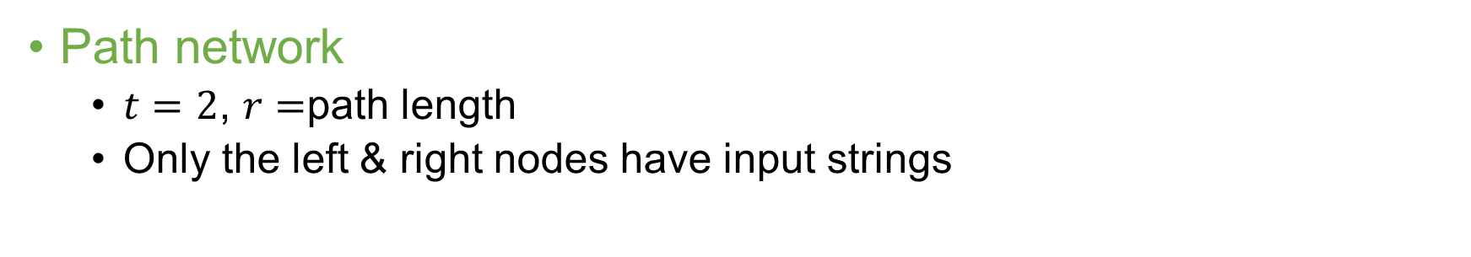

Path
Path network
  $t=2$, $r=$path length
  Only the left & right nodes have input strings
P
$$x$$
$$y$$

Slide 19


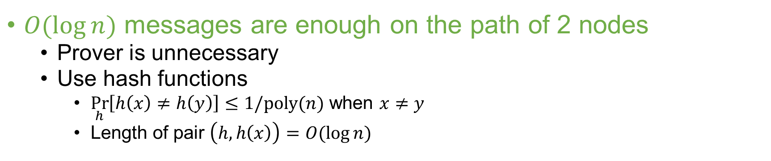


Path (2 nodes): Classical case
$O(\log{n})$ messages are enough on the path of 2 nodes
  Prover is unnecessary
  Use hash functions
    $\underset{h}{Pr}\left[h\left(x\right)≠h\left(y\right)\right]≤1/poly(n)$ when $x≠y$
    Length of pair $\left(h,h\left(x\right)\right)=O(\log{n})$
$h$: randomly chosen
$h′$: randomly chosen
$$x$$
$$(h, h(x))$$
$$y$$
$$(h′, h′(y))$$

Slide 20


Path (3 nodes or more): Classical case
Similar strategy is impossible on the path of 3 nodes as the left node and the right node cannot communicate directly in one round
The case of 3 nodes is similar to the SMP model in communication complexity (since the central node has no information on inputs and his/her simultaneous message is useless)
$h$: randomly chosen
$h′$: randomly chosen
$$x$$
$$(h, h(x))$$
$$(h′, h′(y))$$
$$y$$

Slide 21


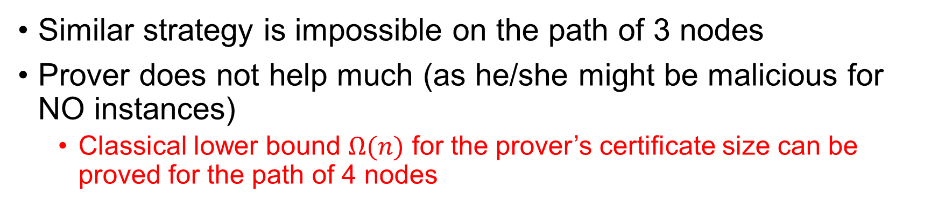
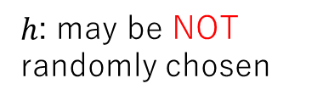

Path (3 nodes or more): Classical case
Similar strategy is impossible on the path of 3 nodes
Prover does not help much (as he/she might be malicious for NO instances)
  Classical lower bound $Ω(n)$ for the prover’s certificate size can be proved for the path of 4 nodes
P
$h$: may be NOT randomly chosen
$$x$$
$$m=(h, h(x))$$
$$y$$
$$m=(h, h(x))$$
$$m=(h, h(x))$$

Slide 22



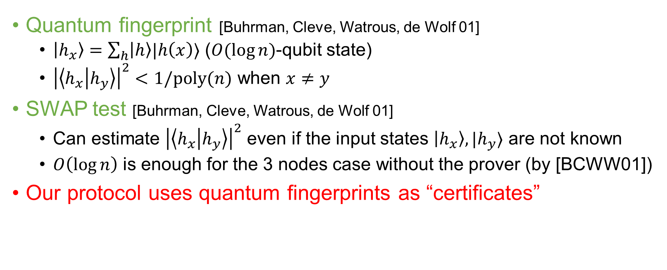
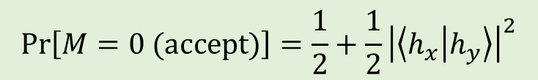




Basic Tools for Quantum Protocol
Quantum fingerprint [Buhrman, Cleve, Watrous, de Wolf 01]
  $\left|h_{x}\right\rangle =\sum_{h}{\left|h\right\rangle |h\left(x\right)⟩}$ ($O(\log{n})$-qubit state)
  ${\left|\left\langle h_{x} | h_{y}\right\rangle \right|}^{2}<1/poly(n)$ when $x≠y$
SWAP test [Buhrman, Cleve, Watrous, de Wolf 01]
  Can estimate ${\left|\left\langle h_{x} | h_{y}\right\rangle \right|}^{2}$ even if the input states $\left|h_{x}\right\rangle , |h_{y}⟩$ are not known
  $O\left(\log{n}\right)$ is enough for the 3 nodes case without the prover (by [BCWW01])
Our protocol uses quantum fingerprints as “certificates”
$$|h_{x}⟩$$
$$|h_{y}⟩$$
$$x$$
$$y$$
$$|0⟩$$
H
H
M
$$\operatorname{Pr}\left[M=0 (accept)\right]=\frac{1}{2}+\frac{1}{2}{\left|\left\langle h_{x} | h_{y}\right\rangle \right|}^{2}$$
$$|h_{x}⟩$$
$$|h_{y}⟩$$

Slide 23








Our Quantum Protocol (Prover phase)
Honest prover (when $x=y$) sends certificate $|h_{x}⟩$ to each of the intermediate nodes
The left node creates $|h_{x}⟩$ and the right node creates $|h_{y}⟩$
P
$$|h_{x}⟩$$
$$|h_{y}⟩$$
$$|h_{x}⟩$$
$$|h_{x}⟩$$
$$|h_{x}⟩$$
$$|h_{x}⟩$$
$$|h_{x}⟩$$
$$x$$
$$y$$

Slide 24


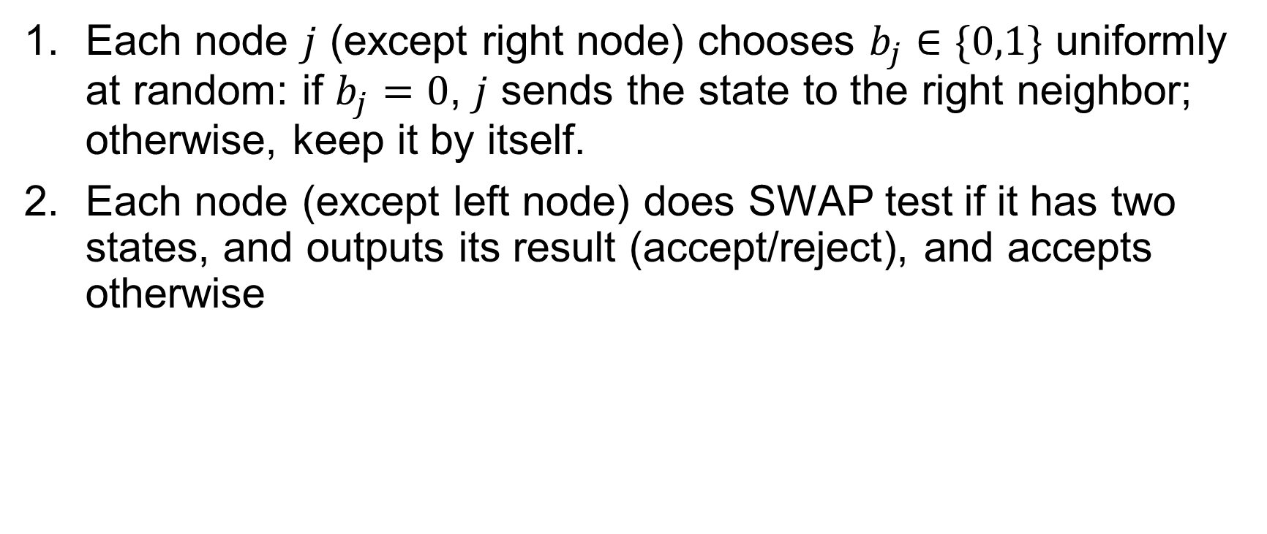
Our Quantum Protocol (Verification phase)
Each node $j$ (except right node) chooses $b_{j}∈\{0,1\}$ uniformly at random: if $b_{j}=0$, $j$ sends the state to the right neighbor; otherwise, keep it by itself.
Each node (except left node) does SWAP test if it has two states, and outputs its result (accept/reject), and accepts otherwise
P
$$|h_{x}⟩$$
$$|h_{y}⟩$$
$$|h_{x}⟩$$
$$|h_{x}⟩$$
$$|h_{x}⟩$$
$$|h_{x}⟩$$
$$|h_{x}⟩$$
$$x$$
$$y$$
$$b_{2}=0$$
$$b_{3}=1$$

Slide 25



Analysis
When $x=y,$all nodes accept with probability 1
P
$$|h_{x}⟩$$
$$\left|W\right\rangle =\left|h_{x}\right\rangle ⊗\left|h_{x}\right\rangle ⊗⋯⊗|h_{x}⟩$$
$$|h_{y}⟩$$
$$x$$
$$y$$

Slide 26


Analysis
When $x=y,$all nodes accept with probability 1
When $x≠y,$ the probability that all nodes accept is $1−Ω(1/r^{2})$
Soundness error can be reduced to 1/3 by $O(r^{2})$ repetitions
P
$$|h_{x}⟩$$
$$\left|W\right\rangle ≠\left|h_{1}\right\rangle ⊗\left|h_{2}\right\rangle ⊗⋯⊗|h_{r−1}⟩$$
$$|h_{y}⟩$$
$$x$$
$$y$$

Slide 27

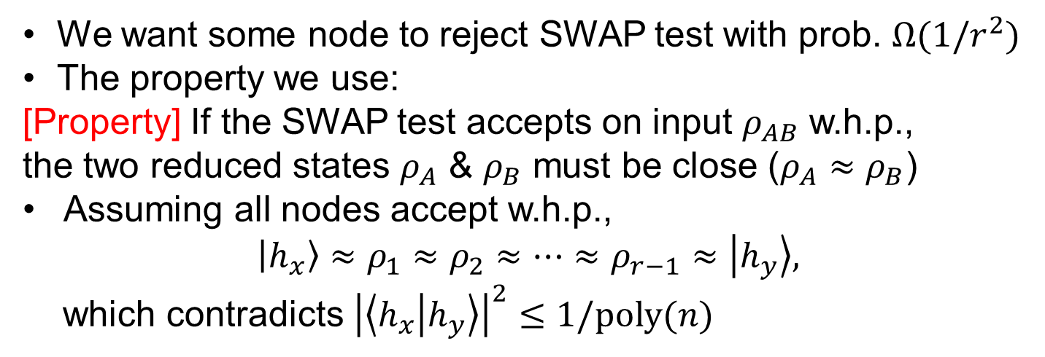
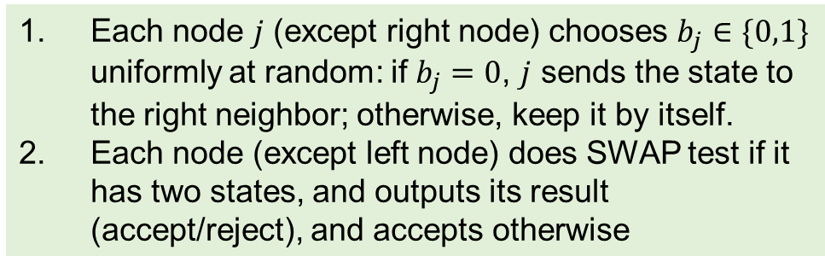











Soundness: $x≠y$ (NO instance)
We want some node to reject SWAP test with prob. $Ω(1/r^{2})$
The property we use:
[Property] If the SWAP test accepts on input $ρ_{AB}$ w.h.p., the two reduced states $ρ_{A}$ & $ρ_{B}$ must be close ($ρ_{A}≈ρ_{B}$)
Assuming all nodes accept w.h.p.,
$$\left|h_{x}\right\rangle ≈ρ_{1}≈ρ_{2}≈⋯≈ρ_{r−1}≈\left|h_{y}\right\rangle ,$$
which contradicts ${\left|\left\langle h_{x} | h_{y}\right\rangle \right|}^{2}≤1/poly(n)$
$$|0⟩$$
H
H
M
$$ρ_{AB}$$
P
Verification phase
$$\left|W\right\rangle ≠\left|h_{1}\right\rangle ⊗⋯⊗|h_{r−1}⟩$$
Each node $j$ (except right node) chooses $b_{j}∈\{0,1\}$ uniformly at random: if $b_{j}=0$, $j$ sends the state to the right neighbor; otherwise, keep it by itself.
Each node (except left node) does SWAP test if it has two states, and outputs its result (accept/reject), and accepts otherwise
$$j$$
$$x$$
$$|h_{x}⟩$$
$$y$$
$$|h_{y}⟩$$
$$b_{j}=0$$
$$b_{j+1}=1$$

Slide 28
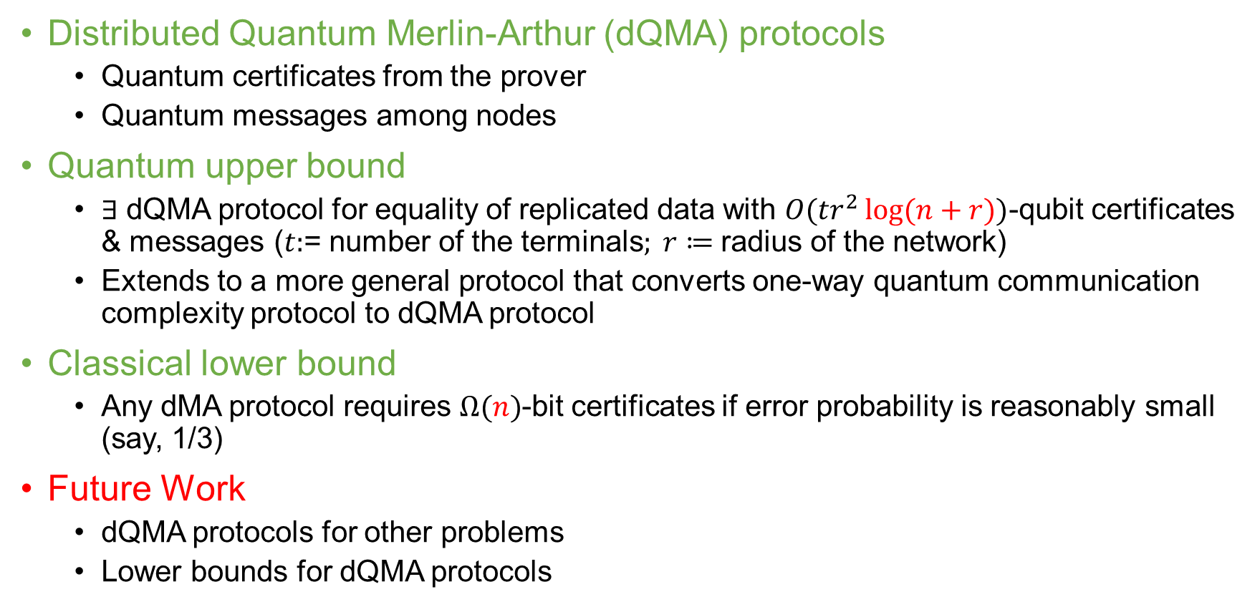
Our Results & Future Work
Distributed Quantum Merlin-Arthur (dQMA) protocols
  Quantum certificates from the prover
  Quantum messages among nodes
Quantum upper bound
  $∃$ dQMA protocol for equality of replicated data with $O(tr^{2}\log{(n+r)})$-qubit certificates & messages ($t:$= number of the terminals$; r≔$ radius of the network)
  Extends to a more general protocol that converts one-way quantum communication complexity protocol to dQMA protocol
Classical lower bound
  Any dMA protocol requires $Ω(n)$-bit certificates if error probability is reasonably small (say, 1/3)
Future Work
  dQMA protocols for other problems
  Lower bounds for dQMA protocols
arXiv: 2002.10018
Proc. ITCS2021

